Slide 1
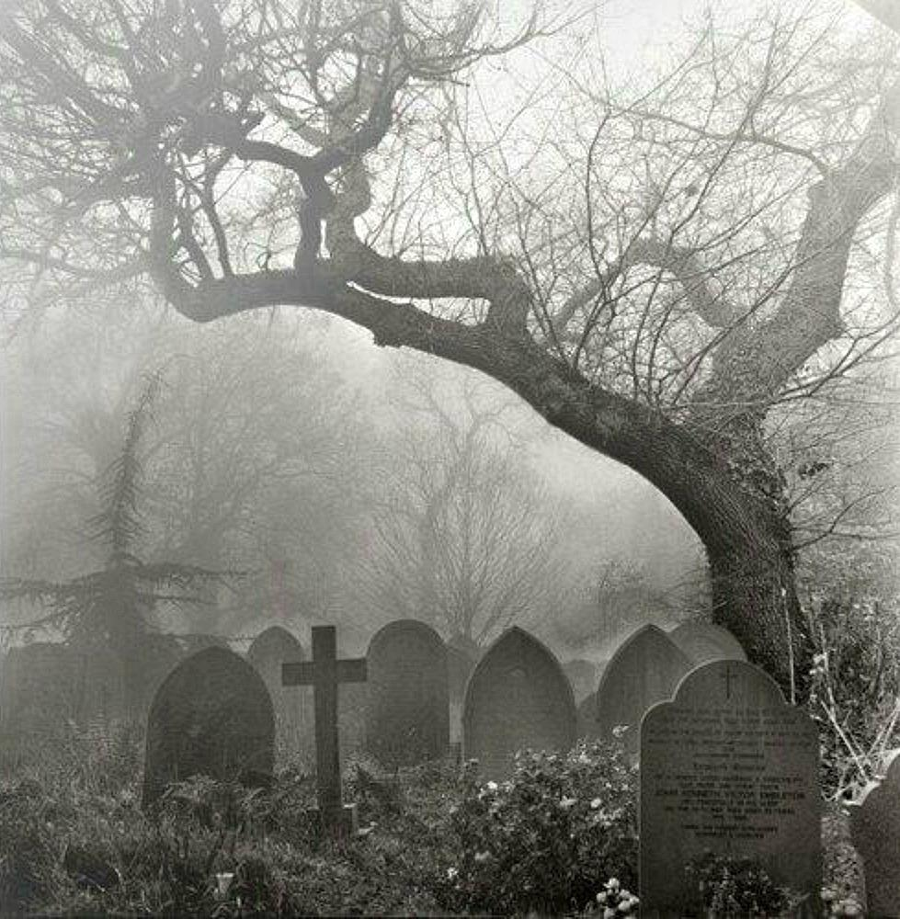
What does it mean to need a Savior?

Slide 2
“It is not those who are healthy who need a physician, but those who are sick.” Matthew 9:12.

Slide 3
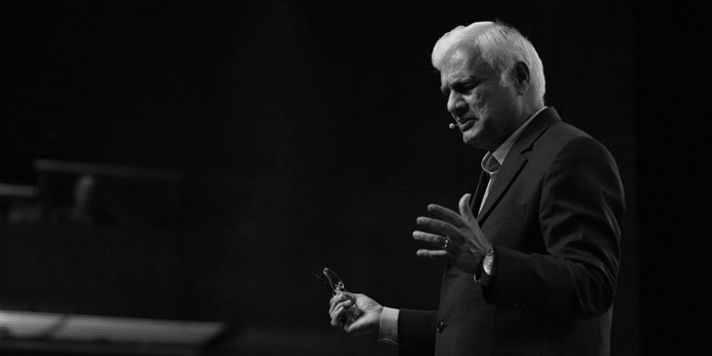
“We are not sinners because we break God’s Moral Law; we break God’s Moral Law because we are sinners.”
Ravi Zacharias
(RZIM.ORG)
Biblecia.com

Slide 4
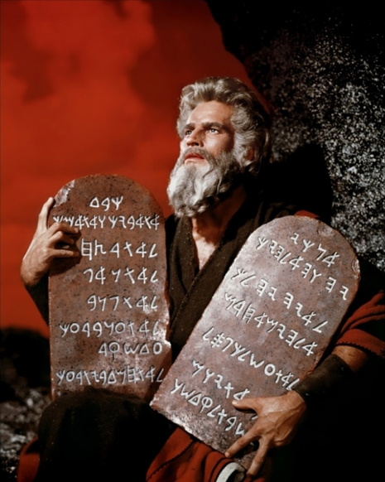
enlarged to show texture

Slide 5
“I would not have come to know sin except through the Law; for I would not have known about coveting if the Law had not said, “You shall not covet.” But sin, taking opportunity through the commandment, produced in me coveting of every kind; for apart from the Law sin is dead. I was once alive apart from the Law; but when the commandment came, sin became alive and I died; and this commandment, which was to result in life, proved to result in death for me; for sin, taking an opportunity through the commandment, deceived me and through it killed me.” Romans 7:7-11

Slide 7
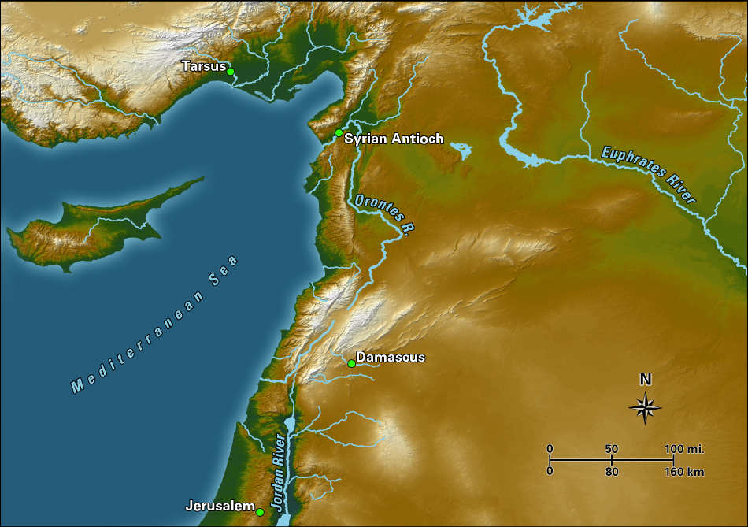

Slide 8
“…a man is not justified by the works of the Law but through faith in Christ Jesus, even we have believed in Christ Jesus, so that we may be justified by faith in Christ and not by the works of the Law; since by the works of the Law no flesh will be justified. … For through the Law I died to the Law, so that I might live to God. I have been crucified with Christ; and it is no longer I who live, but Christ lives in me; and the life which I now live in the flesh I live by faith in the Son of God, who loved me and gave Himself up for me. I do not nullify the grace of God, for if righteousness comes through the Law, then Christ died needlessly.” Galatians 2:16 and 19-21.

Slide 10
“…we too all formerly lived in the lusts of our flesh, indulging the desires of the flesh and of the mind, and were by nature children of wrath, even as the rest.” Ephesians 2:3.
“…you were formerly alienated and hostile in mind, engaged in evil deeds.” Colossians 1:21.
“For I know that nothing good dwells in me, that is, in my flesh; for the willing is present in me, but the doing of the good is not.” Romans 7:18.

Slide 11
“There is none righteous, not even one; There is none who understands, There is none who seeks for God; All have turned aside, together they have become useless; There is none who does good, There is not even one.” “There is no fear of God before their eyes.” Romans 3:9-12 & 18.

Slide 12
“No one can come to Me unless the Father who sent Me draws him.” John 6:44.
“It is the Spirit who gives life; the flesh profits nothing; the words that I have spoken to you are spirit and are life. But there are some of you who do not believe.” For Jesus knew from the beginning who they were who did not believe, and who it was that would betray Him. And He was saying, “For this reason I have said to you, that no one can come to Me unless it has been granted him from the Father.” John 6:63-65.

Slide 13
“For by grace you have been saved through faith; and that not of yourselves, it is the gift of God; not as a result of works, so that no one may boast.” Ephesians 2:8-9.

Slide 14
SIN

Slide 15
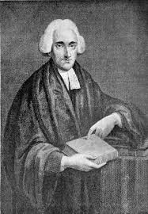
“Nothing in my hands I bring, Simply to Thy cross I cling; Naked, come to Thee for dress, Helpless, look to Thee for grace: Foul, I to the fountain fly, Wash me, Savior, or I die.”

Slide 16
What does it mean to need a Savior?

