Slide 1
lord’s supper service Vilseck, Germany 1 Mar 20

Slide 2
The Exodus

Slide 3
The Passover

Slide 4
“For the Lord will pass through to smite the Egyptians; and when He sees the blood on the lintel and on the two doorposts, the Lord will pass over the door and will not allow the destroyer to come in to your houses to smite you.”
Exodus 12:23

Slide 6
“You shall observe the feast of unleavened bread, for on this very day I brought your hosts out of the land of Egypt. Therefore you shall observe this day throughout your generations as a permanent ordinance.” Exodus 12:17

Slide 7
“And when he had taken some of the bread and given thanks, He broke it and gave it to them, saying, ‘This is my body which is given for you; do this in remembrance of me.’”
Luke 22:19

Slide 9
“And in the same way He took the cup after they had eaten, saying, “This cup which is poured out for you is the new covenant in My blood.”
Luke 22:20

Slide 10
Those marked by the blood of that Passover almost all died in the wilderness, even as Moses did, without entering Israel.
Those marked by Jesus’ blood profess that they have entered a heavenly rest already.

Slide 11
“Truly, truly, I say to you, he who hears My word, and believes Him who sent Me, has eternal life, and does not come into judgment, but has passed out of death into life.”
John 5:24

Slide 12
“…Do you not know that a little leaven leavens the whole lump of dough? Clean out the old leaven so that you may be a new lump, just as you are in fact unleavened. For Christ our Passover also has been sacrificed. Therefore let us celebrate the feast, not with old leaven, nor with the leaven of malice and wickedness, but with the unleavened bread of sincerity and truth.”
1 Corinthians 5:6-8

Slide 14
“The life of the flesh is in the blood, and I have given it to you on the altar to make atonement for your souls; for it is the blood by reason of the life that makes atonement.’”
Leviticus 17:11

Slide 15
“…we have been sanctified through the offering of the body of Jesus Christ once for all. Every priest stands daily ministering and offering time after time the same sacrifices, which can never take away sins; but [Jesus], having offered one sacrifice for sins for all time…has perfected for all time those who are sanctified.”
Hebrews 10:10-14 (omissions)

Slide 17
“Christ appeared as a high priest of the good things to come, He entered through the greater and more perfect tabernacle, not made with hands, that is to say, not of this creation; and not through the blood of goats and calves, but through His own blood, He entered the holy place once for all, having obtained eternal redemption.”
Hebrews 9:11-12

Slide 18
“Anyone who has set aside the Law of Moses dies without mercy on the testimony of two or three witnesses. How much severer punishment do you think he will deserve who has trampled under foot the Son of God, and has regarded as unclean the blood of the covenant by which he was sanctified, and has insulted the Spirit of grace?”
Hebrews 10:28-29

Slide 19
“He who eats My flesh and drinks My blood has eternal life, and I will raise him up on the last day. For My flesh is true food, and My blood is true drink. He who eats My flesh and drinks My blood abides in Me, and I in him. As the living Father sent Me, and I live because of the Father, so he who eats Me, he also will live because of Me. This is the bread which came down out of heaven; not as the fathers ate and died; he who eats this bread will live forever.”
John 6:54-58

Slide 20
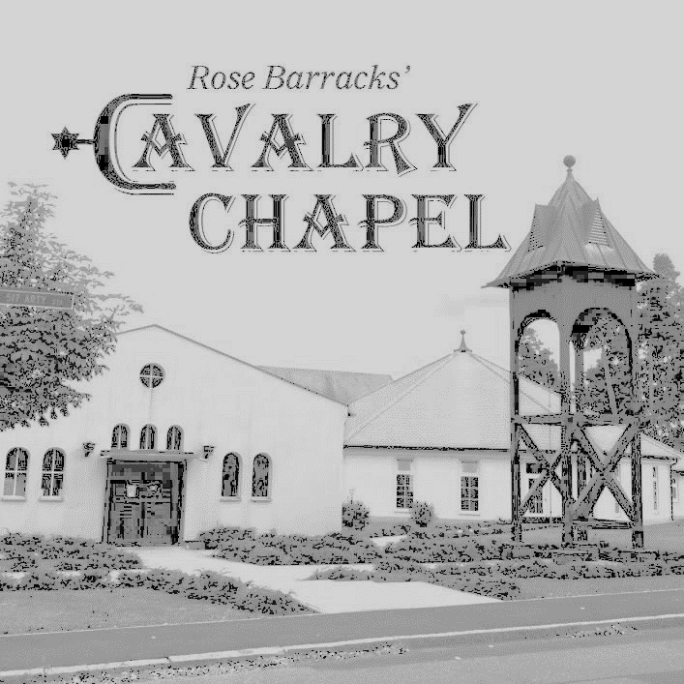
What We Believe
I. GOD
We believe that there is only one living and true God, eternally existing in three distinct persons: Father, Son, and Holy Spirit; that they are equal in every divine perfection, and that they execute distinct but harmonious offices in the work of creation, providence, and redemption. This doctrine has come to be known in history as the Doctrine of the Trinity.
II. JESUS CHRIST
We believe in Jesus Christ, God’s only begotten Son, conceived by the Holy Spirit. We believe in His Virgin Birth, sinless life, miracles, and teachings. We believe in His substitutionary atoning death on the Cross, bodily Resurrection, Ascension into heaven, perpetual intercession for His people, and personal visible return to earth.
III. THE BIBLE
We believe that the Bible is the Word of God, fully inspired and without error in the original manuscripts, written under the inspiration of the Holy Spirit, preserved in transmission and various translations, and has supreme authority in all matters of faith, life, and conduct.
IV. SALVATION
We believe that man was created by God in his own image; that he sinned and thereby became dead in sin, and wholly defiled in soul and body. That as a consequence, all human beings are born with a sinful nature and are sinners by choice and therefore under condemnation. We believe that those who repent of their sin and trust in Jesus Christ as Savior, by the power of the Holy Spirit, are delivered from condemnation and receive eternal life.
V. LAST THINGS
We believe in the personal and visible return of the Lord Jesus Christ to earth and the establishment of His kingdom. We believe in the resurrection of the body, the final judgment, the eternal blessedness of the Christian in heaven and the eternal suffering of the non-Christian in hell.

Slide 21
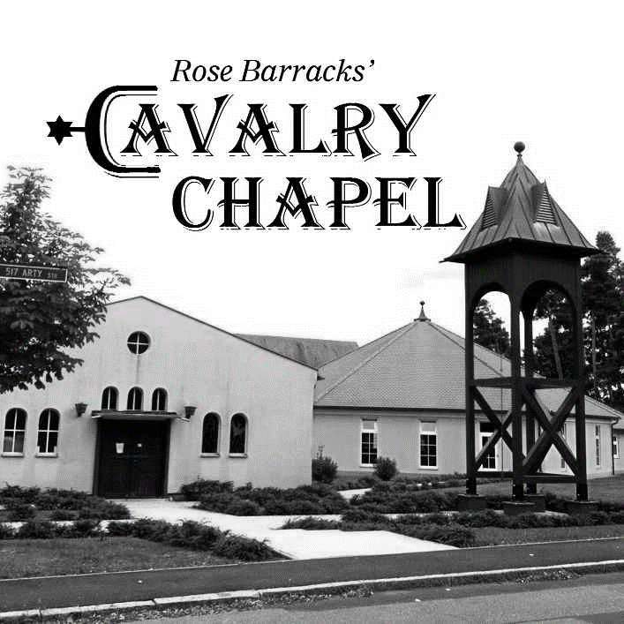
What We Believe
GOD
We believe that there is only one living and true God, eternally existing in three distinct persons: Father, Son, and Holy Spirit; that they are equal in every divine perfection, and that they execute distinct but harmonious offices in the work of creation, providence, and redemption. This doctrine has come to be known in history as the Doctrine of the Trinity.

Slide 22
II. JESUS CHRIST
We believe in Jesus Christ, God’s only begotten Son, conceived by the Holy Spirit. We believe in His Virgin Birth, sinless life, miracles, and teachings. We believe in His substitutionary atoning death on the Cross, bodily Resurrection, Ascension into heaven, perpetual intercession for His people, and personal visible return to earth.
What We Believe

Slide 23
III. THE BIBLE
We believe that the Bible is the Word of God, fully inspired and without error in the original manuscripts, written under the inspiration of the Holy Spirit, preserved in transmission and various translations, and has supreme authority in all matters of faith, life, and conduct.
What We Believe

Slide 24
IV. SALVATION
We believe that man was created by God in his own image; that he sinned and thereby became dead in sin, and wholly defiled in soul and body. That as a consequence, all human beings are born with a sinful nature and are sinners by choice and therefore under condemnation. We believe that those who repent of their sin and trust in Jesus Christ as Savior, by the power of the Holy Spirit, are delivered from condemnation and receive eternal life.
What We Believe

Slide 25
What We Believe
I. GOD
We believe that there is only one living and true God, eternally existing in three distinct persons: Father, Son, and Holy Spirit; that they are equal in every divine perfection, and that they execute distinct but harmonious offices in the work of creation, providence, and redemption. This doctrine has come to be known in history as the Doctrine of the Trinity.
II. JESUS CHRIST
We believe in Jesus Christ, God’s only begotten Son, conceived by the Holy Spirit. We believe in His Virgin Birth, sinless life, miracles, and teachings. We believe in His substitutionary atoning death on the Cross, bodily Resurrection, Ascension into heaven, perpetual intercession for His people, and personal visible return to earth.
III. THE BIBLE
We believe that the Bible is the Word of God, fully inspired and without error in the original manuscripts, written under the inspiration of the Holy Spirit, preserved in transmission and various translations, and has supreme authority in all matters of faith, life, and conduct.
IV. SALVATION
We believe that man was created by God in his own image; that he sinned and thereby became dead in sin, and wholly defiled in soul and body. That as a consequence, all human beings are born with a sinful nature and are sinners by choice and therefore under condemnation. We believe that those who repent of their sin and trust in Jesus Christ as Savior, by the power of the Holy Spirit, are delivered from condemnation and receive eternal life.
V. LAST THINGS
We believe in the personal and visible return of the Lord Jesus Christ to earth and the establishment of His kingdom. We believe in the resurrection of the body, the final judgment, the eternal blessedness of the Christian in heaven and the eternal suffering of the non-Christian in hell.

