Slide 1
Advent Message Love

Slide 2
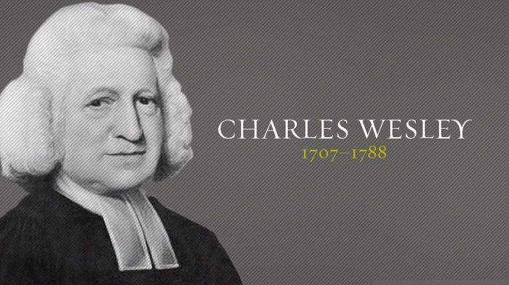
“Amazing love! How can it be that Thou, my God, shouldst die for me? ‘Tis mystery all! The Immortal dies! Who can explore His strange design? In vain the firstborn seraph tries To sound the depths of love divine! ’Tis mercy all! let earth adore, Let angel minds inquire no more.”

Slide 3
John 14:31
“…So that the world may know that I love the Father, I do exactly as the Father commanded Me.”

Slide 4
Romans 5:8
“But God demonstrates His own love toward us, in that while we were yet sinners, Christ died for us.”

Slide 6
1 John 3:1
“See how great a love the Father has bestowed on us, that we would be called children of God…”

Slide 7
Colossians 2:2-4
“…hearts may be encouraged, having been knit together in love, and attaining to all the wealth that comes from the full assurance of understanding, resulting in a true knowledge of God’s mystery, that is, Christ Himself, in whom are hidden all the treasures of wisdom and knowledge.”

Slide 8
2 John 1-6
“The elder to the chosen lady and her children, whom I love in truth; and not only I, but also all who know the truth, for the sake of the truth which abides in us and will be with us forever: Grace, mercy and peace will be with us, from God the Father and from Jesus Christ, the Son of the Father, in truth and love. I was very glad to find some of your children walking in truth, just as we have received commandment to do from the Father. Now I ask you, lady, not as though I were writing to you a new commandment, but the one which we have had from the beginning, that we love one another. And this is love, that we walk according to His commandments. This is the commandment, just as you have heard from the beginning, that you should walk in it.”

Slide 9
John 14:21
“He who has My commandments and keeps them is the one who loves Me; and he who loves Me will be loved by My Father, and I will love him and will disclose Myself to him.”

Slide 10
Luke 6:46-47
“Why do you call Me, ‘Lord, Lord,’ and do not do what I say? ⁴⁷ Everyone who comes to Me and hears My words and acts on them, I will show you whom he is like…”

Slide 11
Exodus 20:5-6
“…I, the Lord your God, am a jealous God, visiting the iniquity of the fathers on the children, on the third and the fourth generations of those who hate Me, but showing lovingkindness to thousands, to those who love Me and keep My commandments.”

Slide 12
John 3:16
“For this is the way God loved the world: He gave his one and only Son, so that everyone who believes in him will not perish but have eternal life.”

Slide 13
1 john 4:10
“In this is love, not that we loved God, but that He loved us and sent His Son to be the propitiation for our sins.”

Slide 14
1 John 2:23
“Whoever denies the Son does not have the Father; the one who confesses the Son has the Father also.”

Slide 15
God’s love
is not
Unconditional

Slide 16
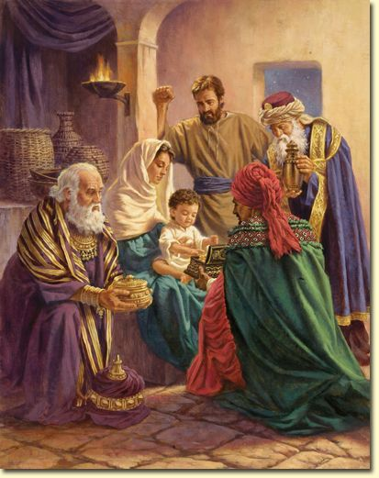

Slide 17
Advent Message Love

