Slide 1
KINGDOM LIVING

Slide 2
MATTHEW 5:8
“Blessed are the pure in heart, for they shall see God.”

Slide 3
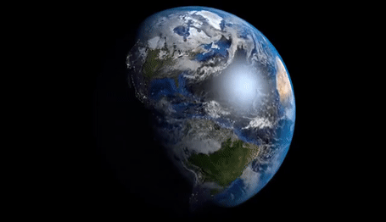
~105,000,000,000

Slide 4
Romans 3:9-12
“…both Jews and Greeks are all under sin; as it is written, ‘There is none righteous, not even one; There is none who understands, There is none who seeks for God; All have turned aside, together they have become useless; There is none who does good, There is not even one.’”

Slide 5
Romans 3:23
but one
“all have sinned and fall short of the glory of God.”

Slide 6
Romans 5:12
“Therefore, just as through one man sin entered into the world, and death through sin, and so death spread to all men, because all sinned.”
Romans 5:19
“Through the one man’s disobedience the many were made sinners, even so through the obedience of the One the many will be made righteous.”

Slide 7
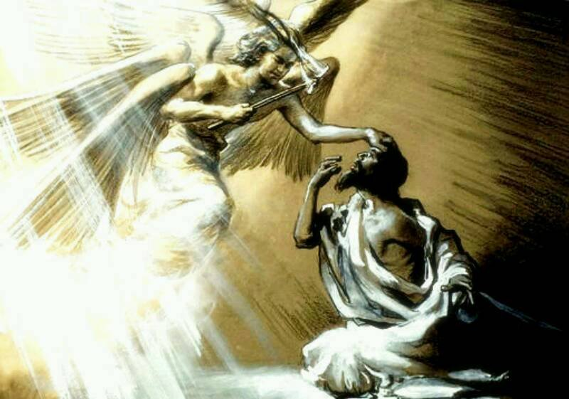
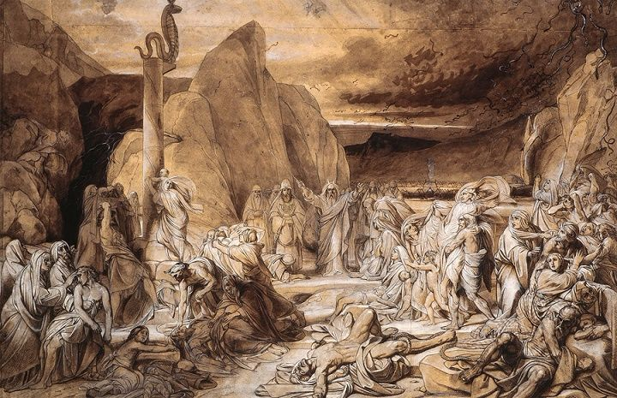
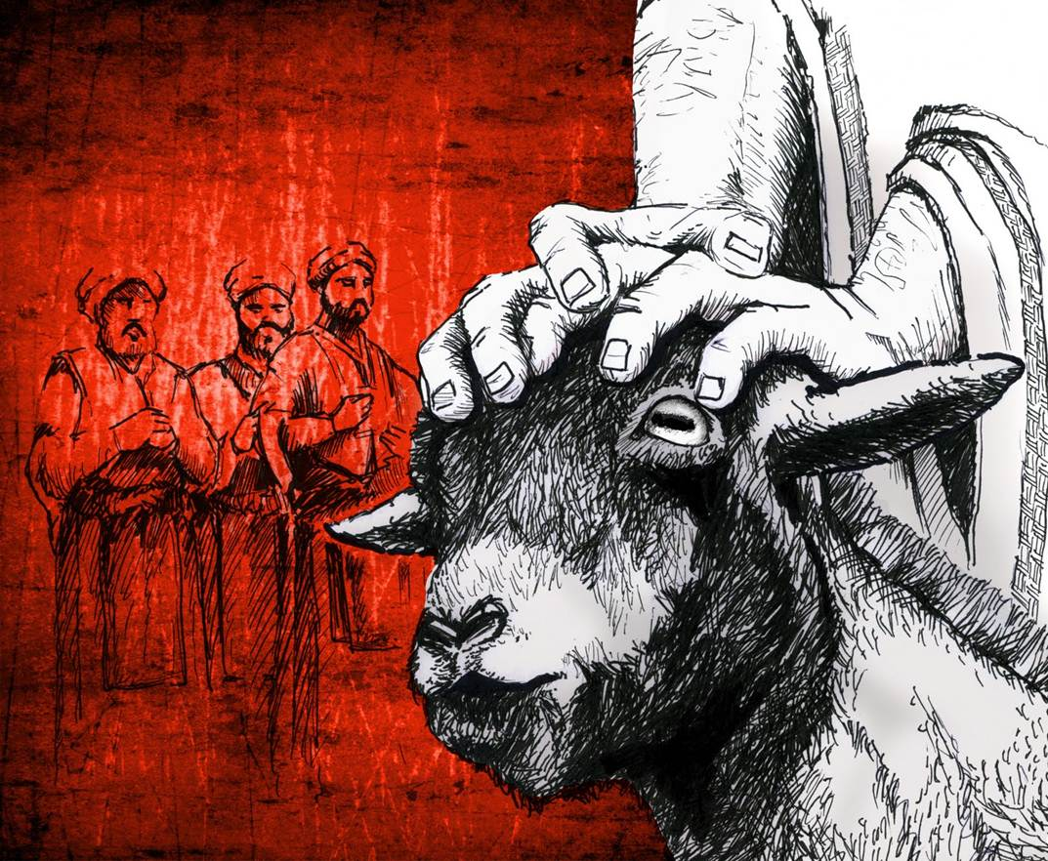
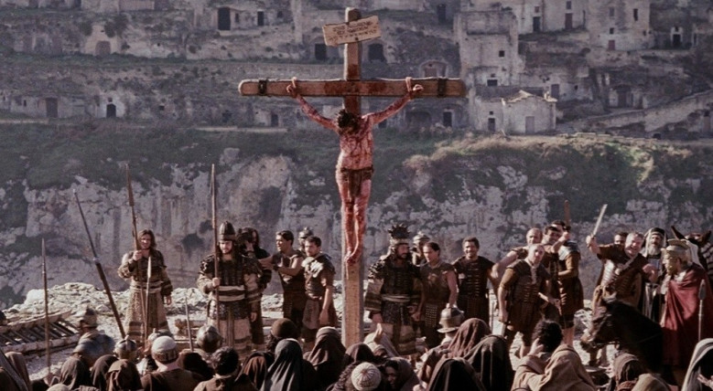
Isaiah 6:6-7
Numbers 21:6-9
Leviticus 16, et al.

Slide 8
Romans 3:21-24
“But now apart from the Law the righteousness of God has been manifested, being witnessed by the Law and the Prophets, even the righteousness of God through faith in Jesus Christ for all those who believe; for there is no distinction; for all have sinned and fall short of the glory of God, being justified as a gift by His grace through the redemption which is in Christ Jesus.”

Slide 9
^{Philippians 3:8-9}
“…I count all things to be loss in view of the surpassing value of knowing Christ Jesus my Lord, for whom I have suffered the loss of all things, and count them but rubbish so that I may gain Christ, 9 and may be found in Him, not having a righteousness of my own derived from the Law, but that which is through faith in Christ, the righteousness which comes from God on the basis of faith.”

Slide 10
“Imputation”

Slide 11
Hebrews 10:11-14
¹¹ “Every priest stands daily ministering and offering time after time the same sacrifices, which can never take away sins; ¹² but He, having offered one sacrifice for sins for all time, sat down at the right hand of God, ¹³ waiting from that time onward until His enemies be made a footstool for His feet. ¹⁴ For by one offering He has perfected for all time those who are sanctified.”

Slide 12
2 Corinthians 5:21
“He made Him who knew no sin to be sin on our behalf, so that we might become the righteousness of God in Him.”

Slide 13
Life
“The Great Exchange”
Life
Death
“He made Him who knew no sin to be sin on our behalf, so that we might become the righteousness of God in Him.”

Slide 14
MATTHEW 5:8
“…for they shall see God.”

Slide 15
^{Romans 5:1-2}
“Therefore, having been justified by faith, we have peace with God through our Lord Jesus Christ, 2 through whom also we have obtained our introduction by faith into this grace in which we stand; and we exult in hope of the glory of God.”

Slide 16
^{John 1:18}
“No one has seen God at any time; the only begotten God who is in the bosom of the Father, He has explained Him.”

Slide 17
^{Revelation 22:3-5}
“There will no longer be any curse; and the throne of God and of the Lamb will be in it, and His bond-servants will serve Him; they will see His face, and His name will be on their foreheads. And there will no longer be any night; and they will not have need of the light of a lamp nor the light of the sun, because the Lord God will illumine them; and they will reign forever and ever.”

Slide 18
KINGDOM LIVING

