Slide 1
KINGDOM LIVING

Slide 2
“BLESSED ARE THE POOR IN SPIRIT.”
MATTHEW 5:1-3
“When Jesus saw the crowds, He went up on the mountain; and after He sat down, His disciples came to Him. ² He opened His mouth and began to teach them, saying, ³ “Blessed are the poor in spirit, for theirs is the kingdom of heaven.”

Slide 4
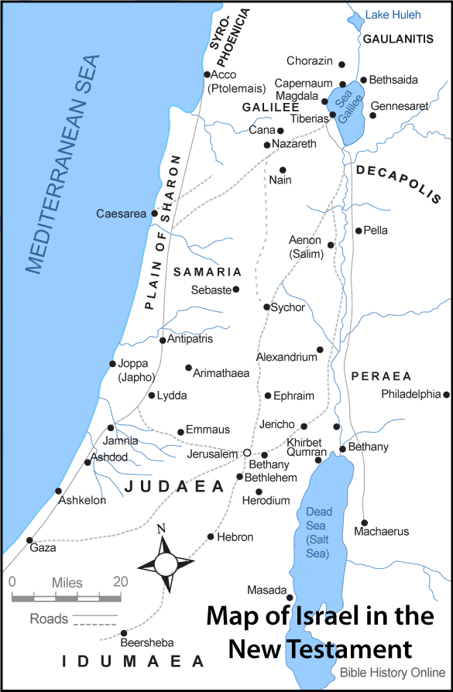

Slide 5
“When Jesus had finished these words, the crowds were amazed at His teaching; ²⁹ for He was teaching them as one having authority, and not as their scribes.” Matthew 7:28-29.

Slide 6
“Blessed are the poor in spirit… Matthew 5:3a.

Slide 7
“…for theirs is the kingdom of heaven.” Matthew 5:3b.

Slide 8
KINGDOM LIVING

