Slide 1
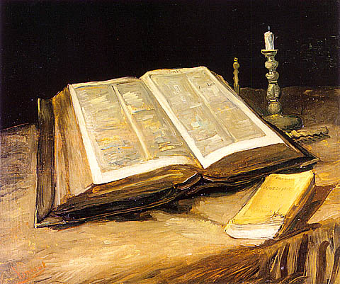
The Holy Bible

Slide 2
Joseph Pittano
www.Biblecia.com

Slide 3
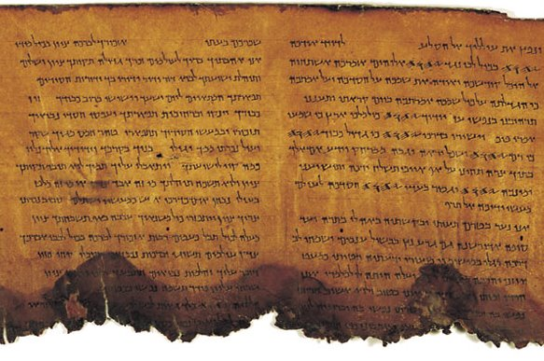
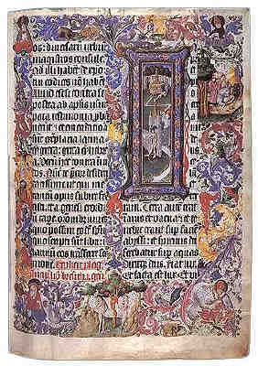
Topics
4 Categories:
1. Historicity/assembly.
2. Textual criticism.
3. The prophetic witness.
4. The Gospel.
Q&A session will follow.

Slide 4
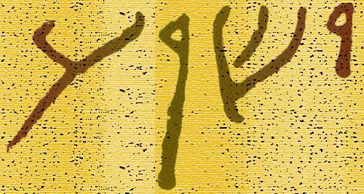
Reliability really matters
From the Bible comes all truth for the Christian.
The Bible is our first and only indispensible source.
Why do Christians still hold to it so closely?
The Bible claims to be the word of God over 2,000 times. It challenges us to prove it.
“Jesus” in 1st Century Hebrew

Slide 5
regarding Facts
We’ll not attempt to prove to you, on the basis of facts and figures alone, that the Bible is true. What we’ll attempt to prove is that it’s accurate.
In our Bibles today, we have what the eyewitnesses wrote in the New Testament by the close of the 1st Century A.D.
We’ll also demonstrate the Old Testament’s accuracy and total reliability in the whole of its writings.

Slide 6
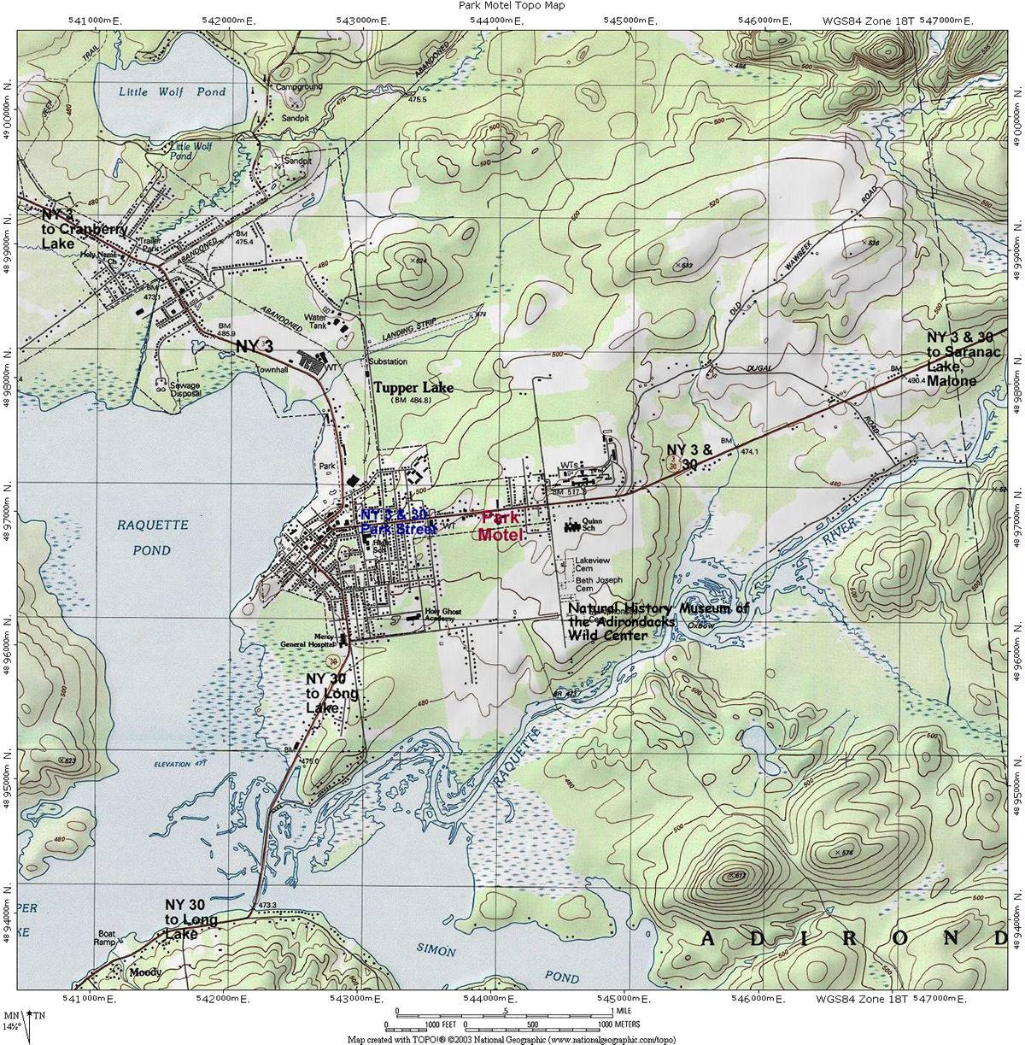
The objective
II
…
TRUST
II

Slide 7
date?
~700 B.C. (Isaiah 53)
BC
AD
Old
Testament
New
Testament

Slide 8
Section 1 Historicity/bible assembly

Slide 9
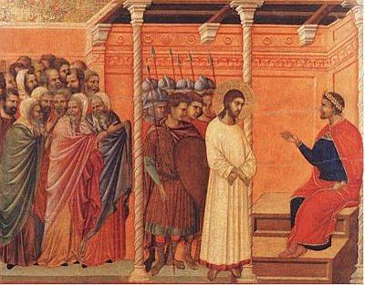
motive
Why write it?
Why like this?

Slide 10
How was it written?
Ch 1: ¹“Inasmuch as many have taken in hand to set in order a narrative of those things which have been fulfilled among us, ² just as those who from the beginning were eyewitnesses and ministers of the word delivered them to us, ³ it seemed good to me also, having had perfect understanding of all things from the very first, to write to you an orderly account, most excellent Theophilus, ⁴ that you may know the certainty of those things in which you were instructed.”
Ch 2: “And it came to pass in those days that a decree went out from Caesar Augustus that all the world should be registered.”
Ch 3: ¹“Now in the fifteenth year of the reign of Tiberius Caesar, Pontius Pilate being governor of Judea, Herod being tetrarch of Galilee, his brother Philip tetrarch of Iturea and the region of Trachonitis, and Lysanias tetrarch of Abilene, ² while Annas and Caiaphas were high priests, the word of God came to John the son of Zacharias in the wilderness.”

Slide 11
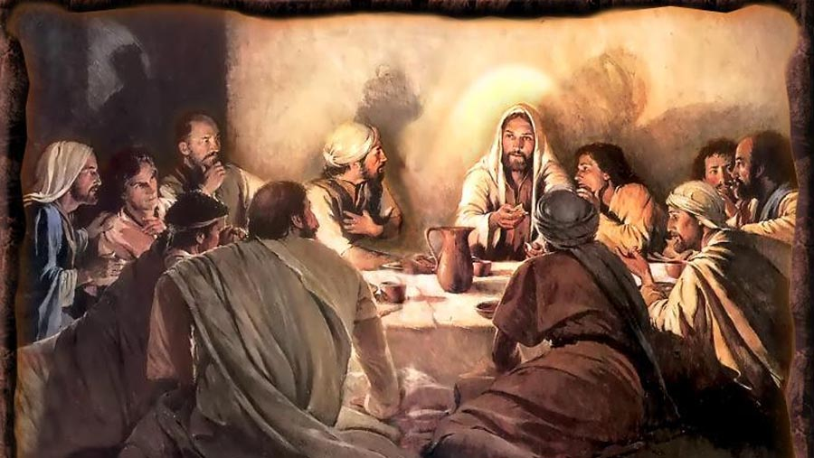
Emmanuel. God with us.

Slide 12
Jesus was born ~ 5 B.C.
Bethlehem Ephrathah

Slide 13
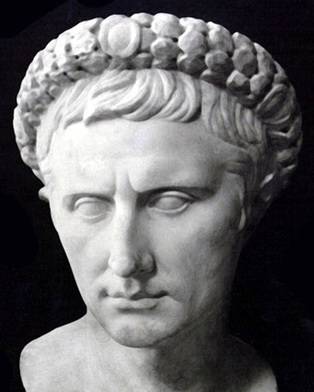
Augustus Caesar
(63 BC - AD 14)
Tiberius Caesar
(AD 14 - 37)

Slide 14
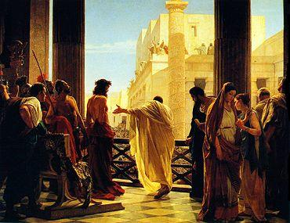
Crucified under Pontius Pilate
Antonio Ciseri’s Ecce Homo

Slide 15
the resurrection Is the reason it’s 2009 a.d.

Slide 16
How we got the bible
The Old Testament
LXX Written:
(~200-150 B.C.)
Inspired/written:
(~1445-430 B.C.)
Israel & Judah
Recognized long before the 1st Century A.D.
The New Testament
27 books canonized:
(A.D. 367-397)
Inspired/written:
(~A.D. 40-100)
Jew & Gentile
Mostly recognized:
(~A.D. 150)

Slide 17
39 O.T.
+ 27 N.T. =
66 Books
www.Biblewheel.com
The Canon of Scripture

Slide 18
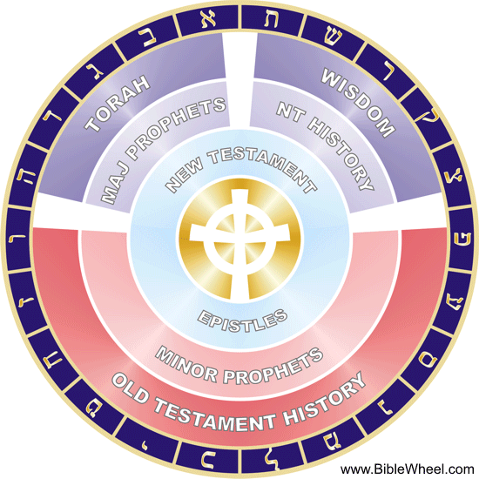
4th Century
www.Biblewheel.com
7 major divisions

Slide 19
Narrowing the gap
~A.D. 1350
Wycliff’s English Bible
A.D. 367
Athanasius’ formal list
983 Yr. time gap
A.D. 367
A.D. 100
267 Yrs
983 Yrs.
A.D. 367
YES
267 Yrs.

Slide 20
The reduction
All of the time between us and them. (~1909 years.)
The time between Wycliffe and Athanasius. (983 years.)
Between Athanasius and the actual writings. (~267 years.)

Slide 21
Accuracy
We can reconstruct the entire New Testament (except ~10 verses) from extra Biblical writers before A.D. 325.
It can therefore be shown historically reliable both:
1. From within itself. (Manuscripts).
2. From outside itself. (History).
This lends tremendous weight to its testimony.

Slide 22
Church leaders
before the canon
Origen
Hippolytus
Eusebius
Justin Martyr
Polycarp
Tertullian
Clement of Alexandria
Irenaeus
Cyprian
New Testament Citations
Between A.D. 70-325 we catalog roughly 32,000 quotations. There are 86,489 direct quotes from outside the Bible cataloged in all.
This list is by no
means exhaustive

Slide 23
Extra-biblical folks
Josephus
Philo
Pliny the Younger
Tacitus
Julian the Apostate
Aristides
Lucian
Suetonius
Porphyry
Historians, non-church leaders
or even antagonists
All verified the Biblical account
This list is also by no
means exhaustive

Slide 24
Section 2 manuscript evidence

Slide 25
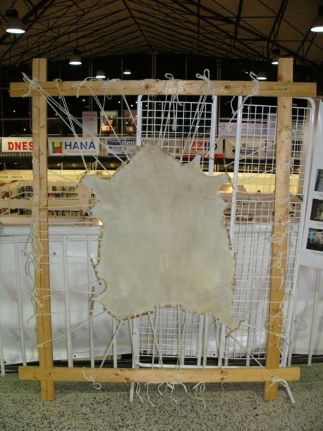
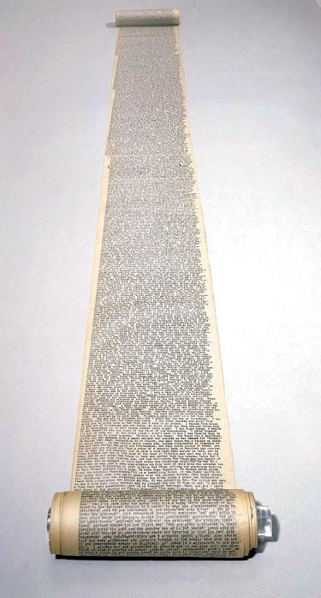
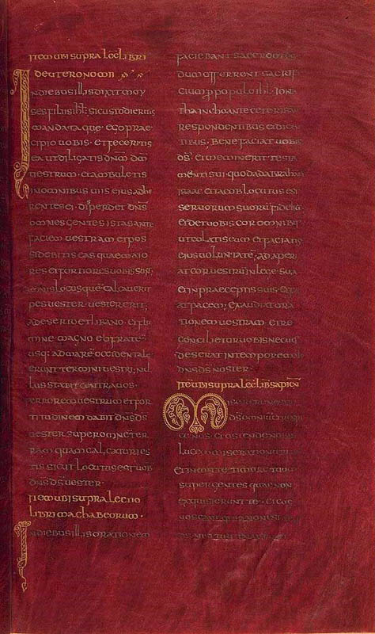
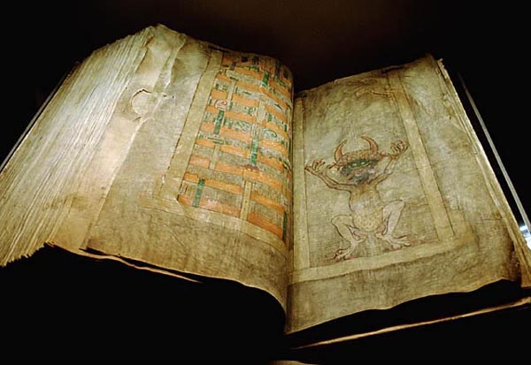
transmission
Papyrus
Papyrus. Pressed strips in perpendicular pattern to make pages.
Parchment. Made from smoothed out animal skins.
Vellum. Calves skin. Sometimes dyed purple and written on with gold or silver.
Leather. Some leather scrolls date to 1500 B.C.
Ostraca. Etched pottery.
Stones.
Wax and clay tablets.
Parchment
Scrolls
Vellum
Codex

Slide 26
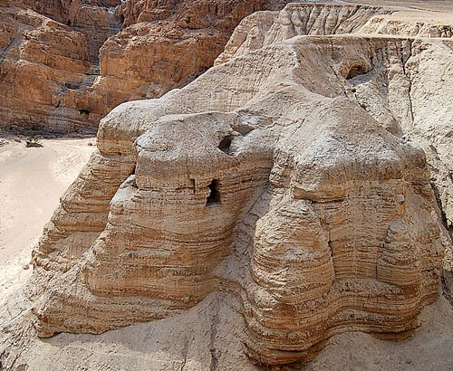
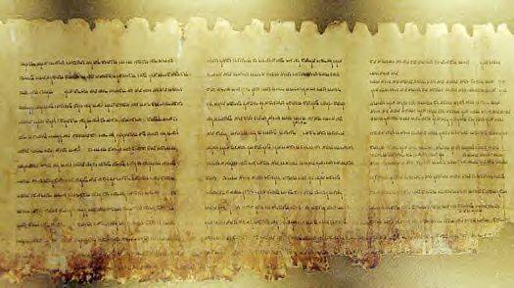
The dead sea scrolls
First discovered in 1947 near Qumran, Israel.
Considered to be among the greatest literary discoveries in history.
Dated ~200 - 100 B.C.

Slide 27
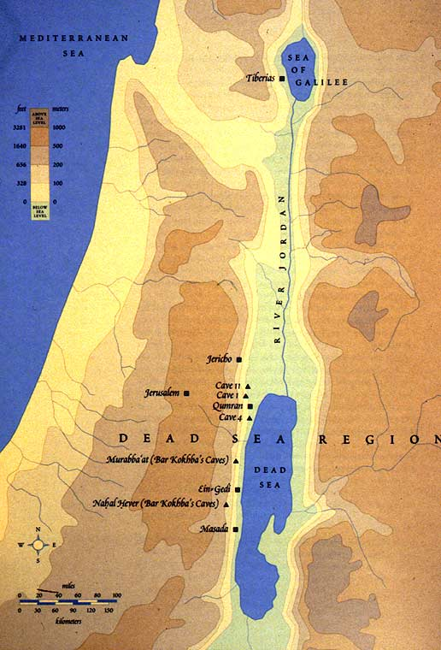
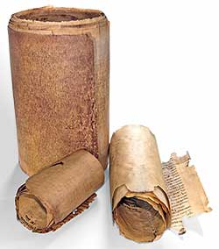
What were they?
~40,000 Inscribed Fragments in all.
More than 500 works were discovered throughout numerous caves.
Every OT book except the book of Esther.
Many extra-biblical books as well.

Slide 28
Manuscripts & fragments
>5,300
643
Homer’s Iliad The New Testament

Slide 29
Author(s) | Date written | Earliest copy | Time span | # of copies
The New Testament | A.D. 40-100 | A.D. 125 | 25 Yrs. | >24,000
Homer’s (The Iliad) | 900 B.C. | 400 B.C. | 500 Yrs. | 643
Caesar | 100-44 B.C. | A.D. 900 | 1,000 Yrs. | 10
Aristotle (Any one work) | 384-322 B.C. | A.D. 1100 | 1,400 Yrs. | 49
Plato ‘s (Tetralogies) | 427-347 B.C. | A.D. 900 | 1,200 Yrs. | 7
Tacitus’ (Annals) | A.D. 100 | A.D. 1100 | 1,000 Yrs. | 20
Pliny the Younger’s (History) | A.D. 61-113 | A.D. 850 | 750 Yrs. | 7
Thucydides’ (History) | 460-400 B.C. | A.D. 900 | 1,300 Yrs. | 8
Suetonius’ (De Vita Caesarum) | A.D. 75-160 | A.D. 950 | 800 Yrs. | 8
Herodotus’ (History) | 480-425 B.C. | A.D. 900 | 1,300 Yrs. | 8
Sophocles | 496-406 B.C. | A.D. 1000 | 1,400 Yrs. | 193
Catullus | 54 B.C. | A.D. 1550 | 1,600 Yrs. | 3
Aristophanes | 450-385 B.C. | A.D. 900 | 1,200 Yrs. | 10
Euripides | 480-406 B.C. | A.D. 1100 | 1,500 Yrs. | 9
Demosthenes | 383-322 B.C. | A.D. 1100 | 1,300 Yrs. | 200

Slide 30
manuscripts
+ >5,300 in Greek and these
we’ve ~ 24,000 total.

Slide 31
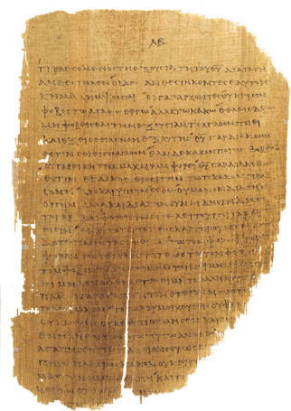
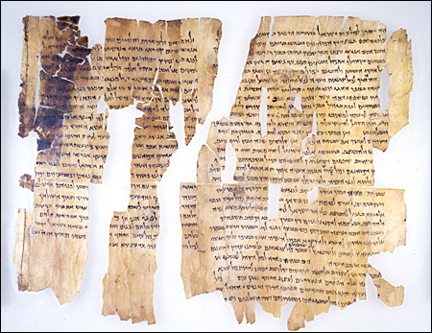
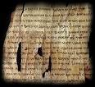
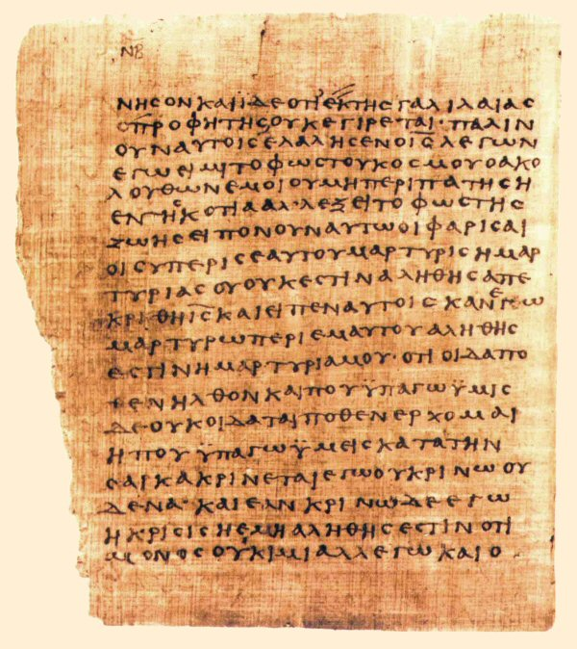
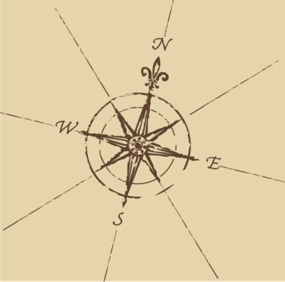
fragments
Asia Minor
Syria
€£µαµáαá αµðæóƱα£ѯαµðæóðƱαáµα¥
αµðæóƱµ €£µαµáαá α£ѯαµðæóðƱáµα¥
€£µαµáαá αµðæóƱα£ѯαµðæóðƱαáµα¥
ðæóáαáó αµðæóƱα£ѯαµðƱαáµ¥æ€£µα
Some fragments date back as far as 2400 B.C.
Egypt
Africa

Slide 32
What Was Heard, Seen, and Touched ¹ That which was from the beginning, which we have heard, which we have seen with our eyes, which we have looked upon, and our hands have handled, concerning the Word of life— ² the life was manifested, and we have seen, and bear witness, and declare to you that eternal life which was with the Father and was manifested to us— ³ that which we have seen and heard we declare to you, that you also may have fellowship with us; and truly our fellowship is with the Father and with His Son Jesus Christ. ⁴ And these things we write to you that your joy may be full.
Fellowship with Him and One Another ⁵ This is the message which we have heard from Him and declare to you, that God is light and in Him is no darkness at all. ⁶ If we say that we have fellowship with Him, and walk in darkness, we lie and do not practice the truth. ⁷ But if we walk in the light as He is in the light, we have fellowship with one another, and the blood of Jesus Christ His Son cleanses us from all sin. ⁸ If we say that we have no sin, we deceive ourselves, and the truth is not in us. ⁹ If we confess our sins, He is faithful and just to forgive us our sins and to cleanse us from all unrighteousness. ¹⁰ If we say that we have not sinned, we make Him a liar, and His word is not in us.
¹ My little children, these things I write to you, so that you may not sin. And if anyone sins, we have an Advocate with the Father, Jesus Christ the righteous. ² And He Himself is the propitiation for our sins, and not for ours only but also for the whole world.
The Test of Knowing Him ³ Now by this we know that we know Him, if we keep His commandments. ⁴ He who says, “I know Him,” and does not keep His commandments, is a liar, and the truth is not in him. ⁵ But whoever keeps His word, truly the love of God is perfected in him. By this we know that we are in Him. ⁶ He who says he abides in Him ought himself also to walk just as He walked. ⁷ Brethren, I write no new commandment to you, but an old commandment which you have had from the beginning. The old commandment is the word which you heard from the beginning.⁸ Again, a new commandment I write to you, which thing is true in Him and in you, because the darkness is passing away, and the true light is already shining. ⁹ He who says he is in the light, and hates his brother, is in darkness until now. ¹⁰ He who loves his brother abides in the light, and there is no cause for stumbling in him. ¹¹ But he who hates his brother is in darkness and walks in darkness, and does not know where he is going, because the darkness has blinded his eyes.
Their Spiritual State ¹² I write to you, little children, Because your sins are forgiven you for His name’s sake. ¹³ I write to you, fathers, Because you have known Him who is from the beginning. I write to you, young men, Because you have overcome the wicked one. Do Not Love the World
¹⁵ Do not love the world or the things in the world. If anyone loves the world, the love of the Father is not in him. ¹⁶ For all that is in the world—the lust of the flesh, the lust of the eyes, and the pride of life—is not of the Father but is of the world. ¹⁷ And the world is passing away, and the lust of it; but he who does the will of God abides forever.

Slide 33
The telephone game fallacy
A message is spoken:
“Dave went to the store for water...”
1. 4.
2. 5.
3. 6.
1st Person
4th
“Dave went to the store for water.”
“Dave vende vacas.” (Spanish).
2nd
5th
“Dave went to the store for milk.”
“Dave’s looking to buy a cow.”
6th
“Dave went out to the store for water.”
3rd
6th
“Dave sells cow milk.”
“Anne despises capitalism.”
What happens, however, if the 1st person writes the statement down and the 6th person reads it?

Slide 34
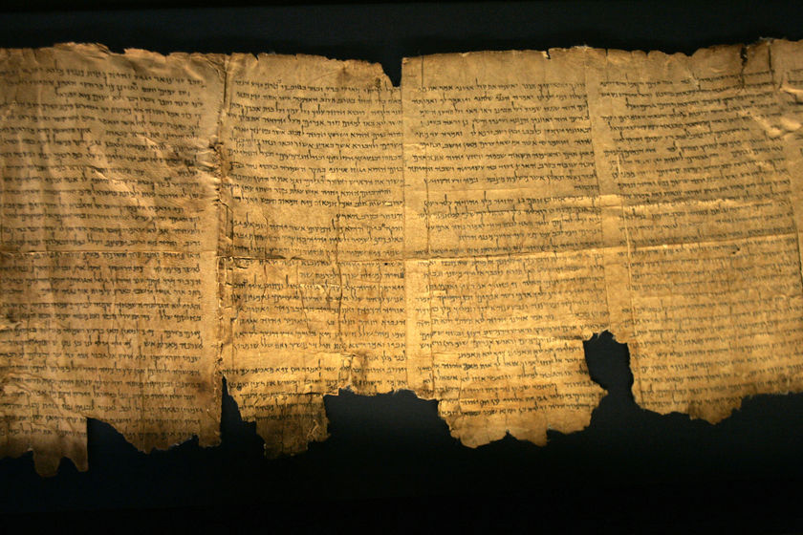
Section 3 Prophecy
Isaiah 46: ⁹“…I am God, and there is no other; I am God, and there is none like Me, ¹⁰ Declaring the end from the beginning, and from ancient times things that are not yet done…”
Statements such as this are everywhere stated and proven in the Scriptures.

Slide 35
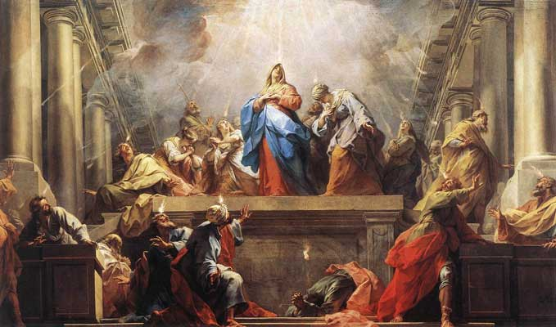
Uniqueness in predictive prophecy
The Koran:
1 author, > 1 lifetime, 0% prophecy.
The Book of Mormon:
1 author, > 1 lifetime, 0% prophecy.
The Bible:
~40 authors, ~ 1,500 years, mind-boggling prophetic power.
Oprah Winfrey:
Out-prophecies the Koran and the Book of Mormon.

Slide 36
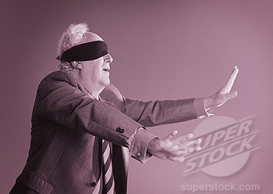
Messianic prophecy and the odds?
X
The odds of Jesus fulfilling all 48 =
1 in 10¹⁵⁷ or 1 in 1,000,000,
000,000,000,000,000,000,000,000,000,000,
000,000,000,000,000,000,000,000,000,000,
000,000,000,000,000,000,000,000,000,000,
000,000,000,000,000,000,000,000,000,000,
000,000,000,000,000,000,000,000,000,000,
0
The odds of Jesus fulfilling just
8 of 48 prophecies =
1 in 10¹⁷ or 1 in 100,000,000,000,000,000
266,852 Square miles
24 inches deep

Slide 37
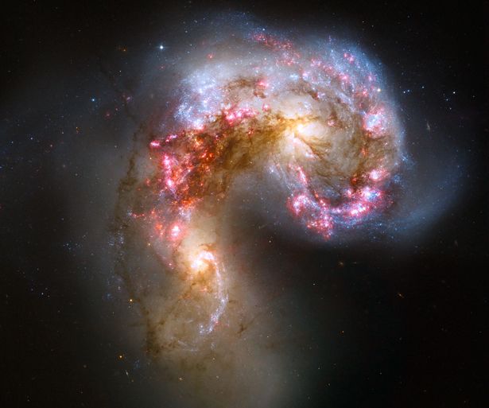
There are only 10⁸⁰ estimated atoms
in the known universe

Slide 38
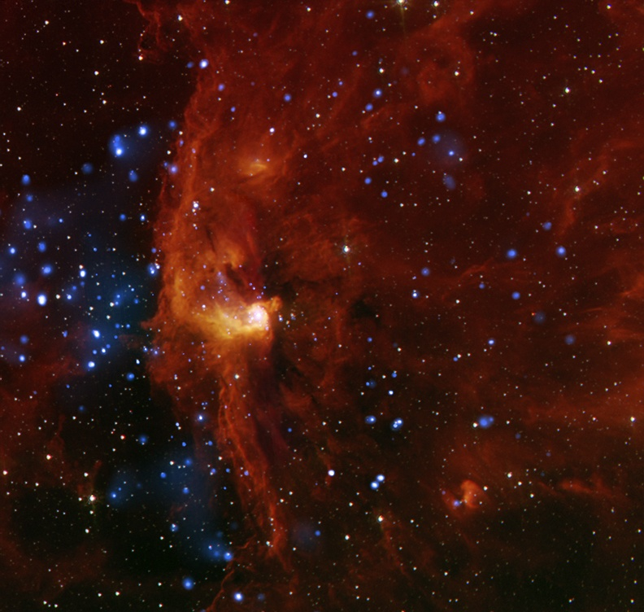
11 prophetic decrees
Tyre
Samaria
Gaza and Ashkelon
Jericho
The Golden Gate
Zion plowed
Jerusalem enlarged
Palestine
Moab and Ammon
Edom
Babylon
1 in 5.76 x 10⁵⁹
1 in 5 x 10⁵⁹

Slide 39
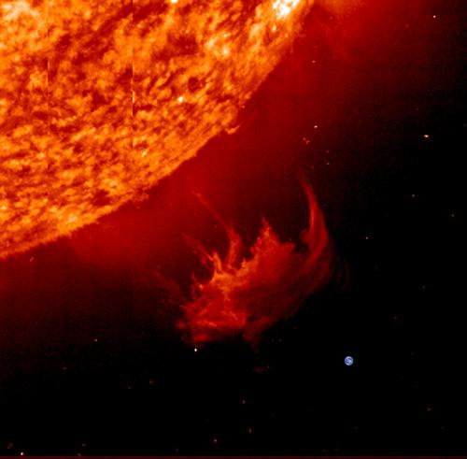
10²⁸ or
1,000,000,000,000,
000,000,000,000,000,0
The sun is more than 1,000,000
Times the size of earth.
Earth

Slide 40
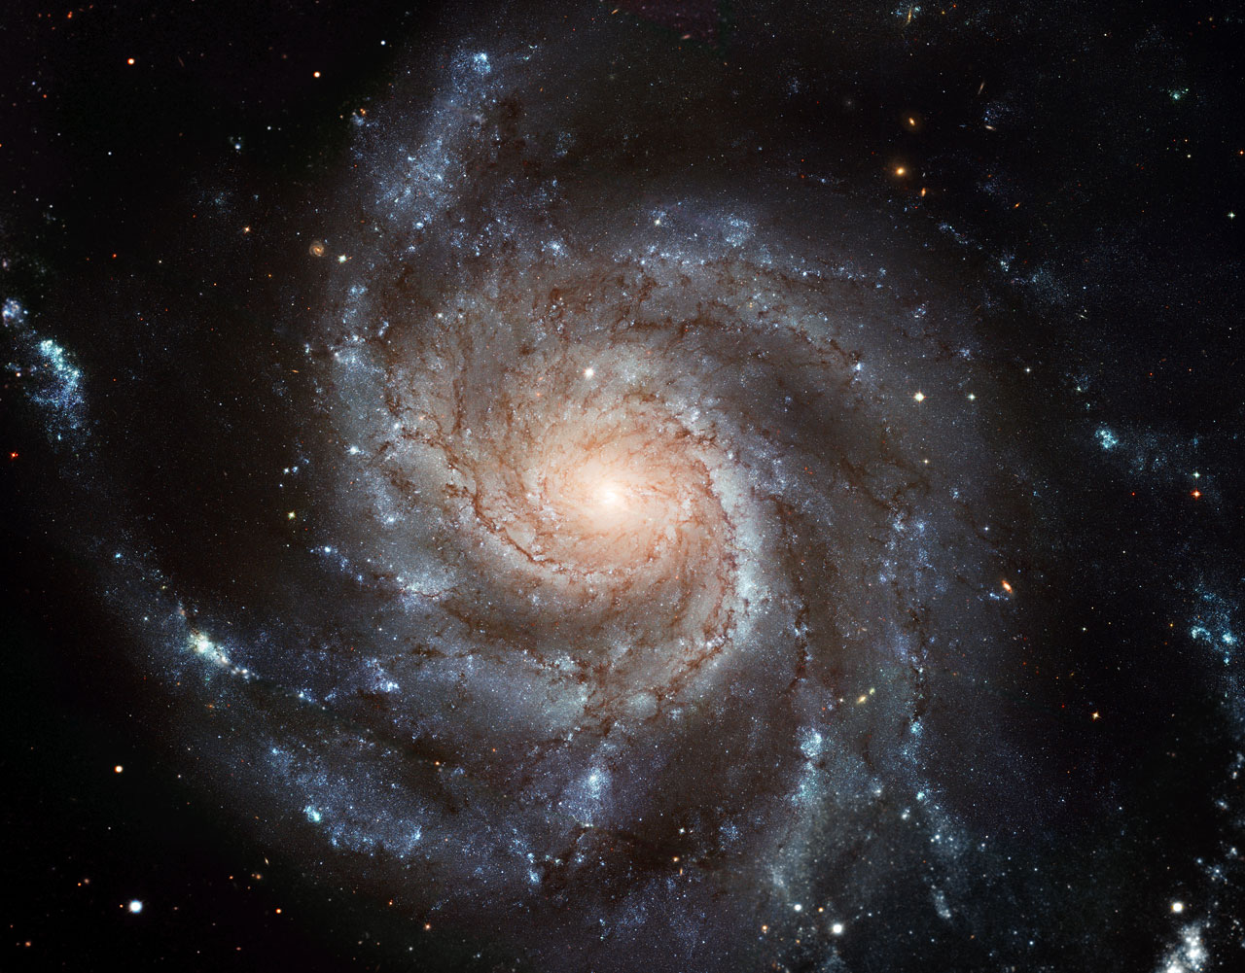
2 x 10⁵ times

Slide 41
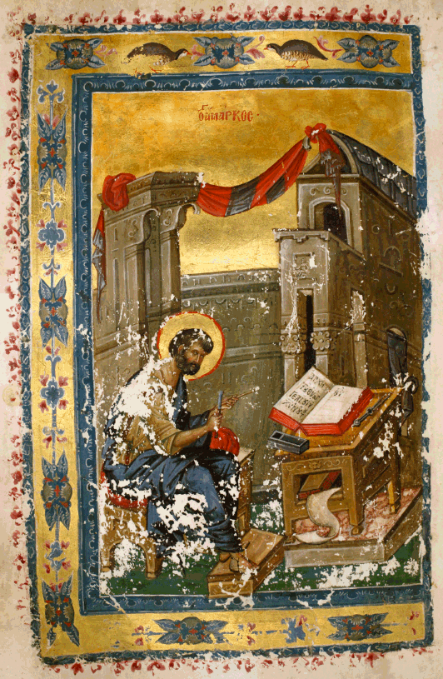
prophecy
Surely we can see that “…No prophecy of Scripture is of any private interpretation, for prophecy never came by the will of man, but holy men of God spoke as they were moved by the Holy Spirit.”
The OT alone contains ~ 2,000 predictive proclamations. Of these we’ve only briefly examined some statistical odds.
Let’s now look to just one example.
Babylon: “All that remains of the original ancient famed city of Babylon today is a mound, or tell, of broken mud-brick buildings and debris in the fertile Mesopotamian plain between the Tigris and Euphrates rivers, in Iraq.” (Wikipedia, Sep 09.)

Slide 42
Geography
Iraq
Modern Day
Baghdad
~ 55 Miles
Ancient
Babylon

Slide 43
Babylon was once 1 of the 7 wonders
The Hanging Gardens

Slide 44
Babylonian excavation in 1932

Slide 45
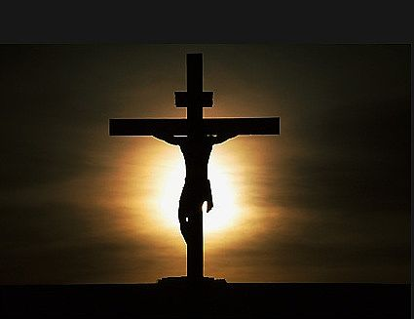
What does it mean?
The Bible is replete with statements like:
“The fear of the LORD is the beginning of wisdom; A good understanding have all those who do His commandments. His praise endures forever.” Psalm 11:10.
“The fear of the LORD is the instruction of wisdom, And before honor is humility.” Proverbs 15:33.

Slide 46
section 4 the gospel
From Mel Gibson’s Passion of the Christ

Slide 47
The relationship
The New Testament
hangs upon the old
The Old Testament
Promised and carried out for ~2183 years

Slide 48
THE
DECALOGUE
I Dishonoring God
II Idolatry
III Blasphemy
IV Forgetting Sabbath
V Dishonoring parents
VI Murder
VII Adultery
VIII Theft
IX Lying
X Covetousness

Slide 49
Earth

Slide 50
Bibliography/recommended sources
Josh McDowell’s Evidence that Demands a Verdict. Volume 1.
www.josh.org
D. James Kennedy’s Why I Believe.
www.coralridge.org
John Macarthur’s sermon series The Sufficiency of Scripture.
www.gty.org
Michael Patton’s theology series Bibliology and Hermeneutics.
http://bible.org/series/bibliology-and-hermeneutics
Alistair Begg’s sermon series Why bother with the Bible?
www.truthforlife.org
Randall Niles.
www.allaboutthejourney.org
F.F. Bruce’s The Canon of Scripture.
www.monergism.com. Many resources on the canon.
Wayne Grudem’s Systematic Theology. Part 1.

Slide 51
The Holy Bible
Question & Answer Session

