Slide 1
This slide will be explained
at the close of part two

Slide 2
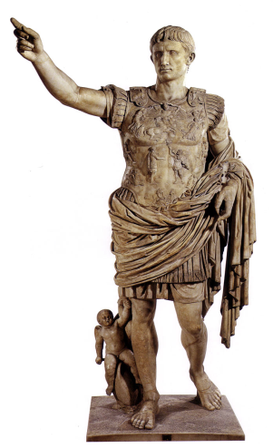
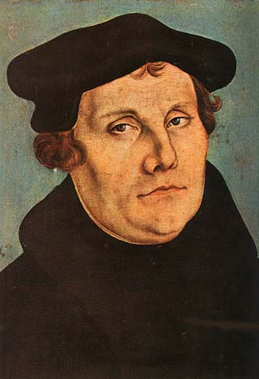
Our attributes
A heart of flesh
Devotion to God
Will
“…but on God who shows mercy.”
“It is the Spirit who gives life. The flesh profits nothing,”
John 6:63.
Forgiveness
Trust in God
That “nothing” is not
even a little
“something!”
– Luther.
Will
Understanding of grace
“It [Salvation] does not depend on the man who wills or the man who runs…” Romans 9.
Creativity
Contrition
Honor
Repentance
A new creation…2nd birth
Knowledge of God
Freedom
Of natural man…1st birth
Ethics
Intellect
Assurance
Character
Justice
The mind of
Christ
Reason
Love
Attrition
Conscience
Determination
Desire

