Slide 1
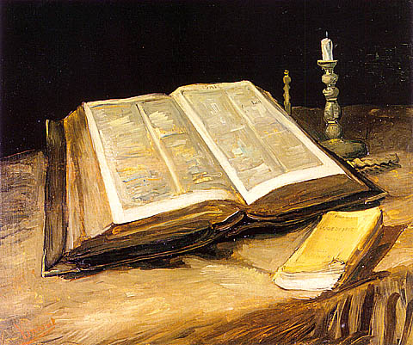
Predestination study
16 Sep 11
Part 3-
Continuing Through Romans 9

Slide 2
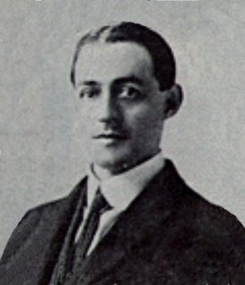
In one of his letters to Erasmus, Luther said, "Your thoughts of God are too human." Probably that renowned scholar resented such a rebuke, the more so, since it proceeded from a miner’s son; nevertheless, it was thoroughly deserved. We too, though having no standing among the religious leaders of this degenerate age, prefer the same charge against the majority of the preachers of our day, and against those who, instead of searching the Scriptures for themselves, lazily accept the teaching of others. The most dishonoring and degrading conceptions of the rule and reign of the Almighty are now held almost everywhere. To countless thousands, even among those professing to be Christians, the God of the Scriptures is quite unknown. Of old, God complained to an apostate Israel, Thou thoughtest that I was altogether as thyself. (Ps. 50:21). Such must now be His indictment against an apostate Christendom. Men imagine that the Most High is moved by sentiment, rather than actuated by principle. They suppose that His omnipotency is such an idle fiction that Satan is thwarting His designs on every side. They think that if He has formed any plan or purpose at all, then it must be like theirs, constantly subject to change. They openly declare that whatever power He possesses must be restricted, lest He invade the citadel of man’s "free will" and reduce him to a "machine." They lower the all efficacious Atonement, which has actually redeemed everyone for whom it was made, to a mere "remedy," which sin-sick souls may use if they feel disposed to; and they enervate the invincible work of the Holy Spirit to an "offer" of the Gospel which sinners may accept or reject as they please. The "god" of this twentieth century no more resembles the Supreme Sovereign of Holy Writ than does the dim flickering of a candle the glory of the midday sun. The "god" who is now talked about in the average pulpit, spoken of in the ordinary Sunday School, mentioned in much of the religious literature of the day, and preached in most of the so-called Bible Conferences is the figment of human imagination, an invention of maudlin sentimentality. The heathen outside of the pale of Christendom form "gods" out of wood and stone, while the millions of heathen inside Christendom manufacture a "god" out of their own carnal mind. In reality, they are but atheists, for there is no other possible alternative between an absolutely supreme God, and no God at all. A "god" whose will is resisted, whose designs are frustrated, whose purpose is checkmated, possesses no title to Deity, and so far from being a fit object of worship, merits nought but contempt. The supremacy of the true and living God might well be argued from the infinite distance which separates the mightiest creatures from the almighty Creator. He is the Potter, they are but the clay in His hands to be molded into vessels of honor, or to be dashed into pieces (Ps. 2-9) as He pleases. Were all the denizens of heaven and all the inhabitants of the earth to combine in revolt against Him, it would occasion Him no uneasiness, and would have less effect upon His eternal and unassailable Throne than has the spray of Mediterranean’s waves upon the towering rocks of Gibraltar. So puerile and powerless is the creature to affect the Most High, Scripture itself tells us that when the Gentile heads unite with apostate Israel to defy Jehovah and His Christ, "He that sitteth in the heavens shall laugh" (Ps. 2:4).
A.W. Pink
The Attributes of God (Ch 5).
Notes:
http://www.davidcox.com.mx/library/P/Pink%20-%20Attributes%20of%20God%20(b).pdf

Slide 3
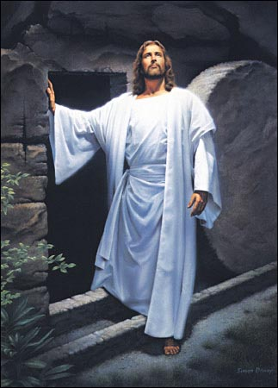
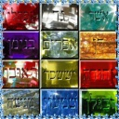
Equally
purposeful
Purposeful
This is where we get things like:
“For this reason He is the mediator of a new covenant,
so that, since a death has taken place for the redemption of the transgressions that were committed under the first covenant, those who have been
called may receive the promise of the eternal inheritance,” Hebrews 9:15.
“I pray for them. I do not pray for the world but for those whom You have given Me, for they are Yours,” John 17:9.
“The Lord is not slow about His promise, as some count slowness, but is patient toward you, not wishing for any to perish but for all to come to repentance,” 2 Peter 3:9.
This the definition, for me, of limited atonement.
“As the Father knows Me, even so I know the Father; and I lay down My life for the sheep. And other sheep I have which are not of this fold; them also I must bring, and they will hear My voice,” John 10:15-16.
“The high priest enters once a year, not without taking blood, which he offers for himself and for the sins of the people…” Hebrews 9:7.
“Even us, whom He also called, not from among Jews only, but also from among Gentiles,” Romans 9:24.

Slide 4
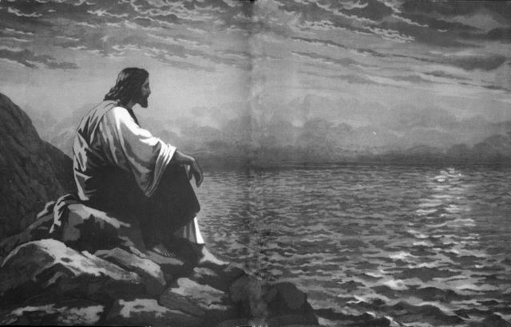
14-18
Let’s read 6-13 quickly
No transition. We go straight from Jacob and Esau to this Pharaoh. These are all specific individuals. As such, they may have national implication…and vice versa.
These are now spoken of as universally applicable generalities or principles.
“What shall we say then? There is no injustice with God, is there? May it never be! For He says to Moses, “I WILL HAVE MERCY ON WHOM I HAVE MERCY, AND I WILL HAVE COMPASSION ON WHOM I HAVE COMPASSION.” So then it does not depend on the man who wills or the man who runs, but on God who has mercy. For the Scripture says to Pharaoh, “FOR THIS VERY PURPOSE I RAISED YOU UP, TO DEMONSTRATE MY POWER IN YOU, AND THAT MY NAME MIGHT BE PROCLAIMED THROUGHOUT THE WHOLE EARTH.” So then He has mercy on whom He desires, and He hardens whom He desires.”
What do we do with such hardening? It is all over the place.
Some people claim that Jesus simply made salvation possible for all. That He moves to all equally or would equally have all to be saved if they would only wish it, “Of their will.”
So what do we do with God ever (at any time) hardening people? Yes, it is in response to the hardness of their own hearts, but some say God would NEVER withhold salvation.
“The coming of the lawless one is according to the working of Satan, with all power, signs, and lying wonders, and with all unrighteous deception among those who perish, because they did not receive the love of the truth, that they might be saved. And for this reason God will send them strong delusion, that they should believe the lie, that they all may be condemned who did not believe the truth but had pleasure in unrighteousness,” 2 Thessalonians 2:9-12.
“In that hour Jesus rejoiced in the Spirit and said, “I thank You, Father, Lord of heaven and earth, that You have hidden these things from the wise and prudent and revealed them to babes. Even so, Father, for so it seemed good in Your sight,” Luke 10:21.
“The LORD said to Moses, “When you go back to Egypt, see that you do all those wonders before Pharaoh which I have put in your hand. But I will harden his heart, so that he will not let the people go,” Exodus 4:21.
Pharaoh later indeed does harden his own heart.
1
2

Slide 5
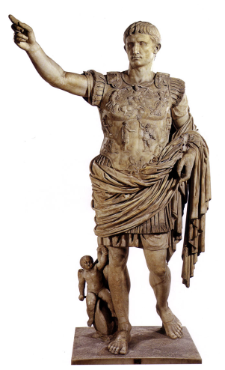
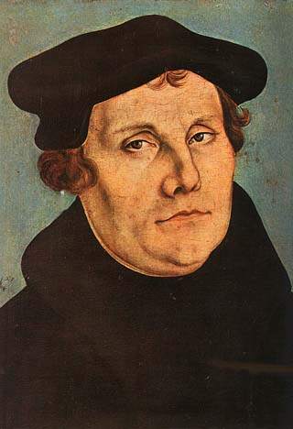
Our attributes
A heart of flesh
Devotion to God
Will
“…but on God who shows mercy.”
“It is the Spirit who gives life. The flesh profits nothing,”
John 6:63.
Forgiveness
Trust in God
That “nothing” is not
even a little
“something!”
– Luther.
Will
Understanding of grace
“It [Salvation] does not depend on the man who wills or the man who runs…” Romans 9.
Creativity
Contrition
Honor
Repentance
A new creation…2nd birth
Knowledge of God
Freedom
Of natural man…1st birth
Ethics
Intellect
Assurance
Character
Justice
The mind of
Christ
Reason
Love
Attrition
Conscience
Determination
Desire

Slide 6
“So the LORD said to Moses: “See, I have made you as
God to Pharaoh, and Aaron your brother shall be
your prophet. You shall speak all that I command you.
And Aaron your brother shall tell Pharaoh to send the
children of Israel out of his land.
And I will harden Pharaoh’s heart,
and multiply My signs and My wonders in the
land of Egypt. But Pharaoh will not heed you,
so that I may lay My hand on Egypt and
bring My armies and My people, the
children of Israel, out of the land of Egypt by
great judgments. And the Egyptians shall know
that I am the LORD, when I stretch out My hand on
Egypt and bring out the children
of Israel from among them,” Exodus 7:1-5.
How could God say this for sure before they met?
2) What if pharaoh had said “OK.”?
Before they met

Slide 7
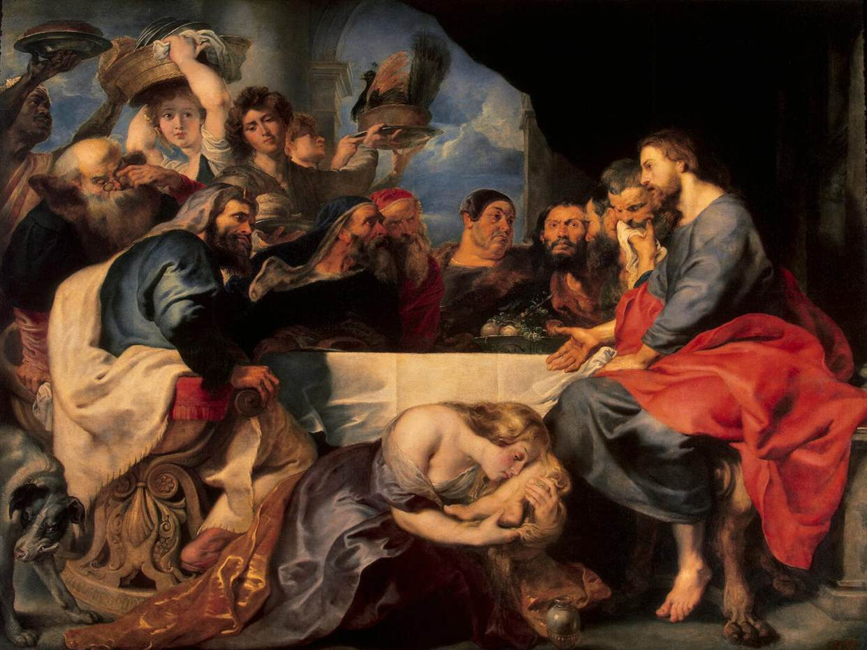
grace is god’s to give
“And the disciples came and said to Him, “Why do You speak to them in parables?” He answered and said to them, “Because it has been given to you to know the mysteries of the kingdom of heaven, but to them it has not been given. For whoever has, to him more will be given, and he will have abundance; but whoever does not have, even what he has will be taken away from him. Therefore I speak to them in parables, because seeing they do not see, and hearing they do not hear, nor do they understand. And in them the prophecy of Isaiah is fulfilled…” Matthew 13:10-14a. Quotes Isaiah 6:9-10.

Slide 8
18-22
Again there’s no transition. It is straight from Jacob and Esau to the Pharaoh to now to anyone and everyone.
“You will say to me then, “Why does He still find fault? For who resists His will?” (NASB).
“Thou wilt say then unto me, Why doth he yet find fault? For who hath resisted his will?” (KJV).
“One of you will say to me: “Then why does God still blame us? For who is able to resist his will?” (NIV).
Here is another clearly anticipated objection. Can it be clearer why?
The natural man/part of us objects because we hear clearly.
Remember, these truths are simply stated; it’s their implications that are difficult. We must wrestle our presuppositions into what we know of God.
NLT: “So you see, God chooses to show mercy to some, and he chooses to harden the hearts of others so they refuse to listen.“Well then, you might say, “Why does God blame people for not responding? Haven’t they simply done what he makes them do?” No, don’t say that. Who are you, a mere human being, to argue with God? Should the thing that was created say to the one who created it, “Why have you made me like this?” When a potter makes jars out of clay, doesn’t he have a right to use the same lump of clay to make one jar for decoration and another to throw garbage into?”
1. Who does?
Fallen
Humanity
2. Who has?
The elect
3. Who can?

Slide 9
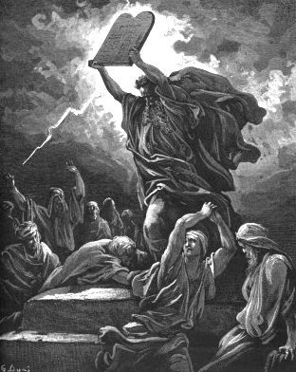
23-29
Soli Deo gloria!
“And He did so to make known the riches of His glory upon vessels of mercy, which He prepared beforehand for glory, even us, whom He also called, not from among Jews only, but also from among Gentiles. As He says also in Hosea,
“I WILL CALL THOSE WHO WERE NOT MY PEOPLE, ‘MY PEOPLE,’ AND HER WHO WAS NOT BELOVED, ‘BELOVED.’” “AND IT SHALL BE THAT IN THE PLACE WHERE IT WAS SAID TO THEM, ‘YOU ARE NOT MY PEOPLE,’ THERE THEY SHALL BE CALLED SONS OF THE LIVING GOD.”
Isaiah cries out concerning Israel, “THOUGH THE NUMBER OF THE SONS OF ISRAEL BE LIKE THE SAND OF THE SEA, IT IS THE REMNANT THAT WILL BE SAVED; FOR THE LORD WILL EXECUTE HIS WORD ON THE EARTH, THOROUGHLY AND QUICKLY.” And just as Isaiah foretold,
“UNLESS THE LORD OF SABAOTH HAD LEFT TO US A POSTERITY, WE WOULD HAVE BECOME LIKE SODOM, AND WOULD HAVE RESEMBLED GOMORRAH.”
Both Jews and
Gentiles can and should now proclaim this!

Slide 10
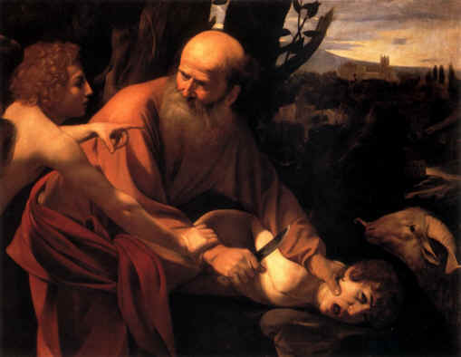
Conclusion
Paul concludes the chapter sharing about the gift of faith and its being given to the Gentiles in the hopeful provocation of the Jews.
We will see more about the remnant he speaks of soon.
God himself is the focus of these teachings regarding faithfulness whether we’re speaking of Abraham, Isaac, Jacob, Moses, the peoples divided into Jews or Gentiles, or any individual.
We’ve already concluded that faith is a free gift, Ephesians 2. I pray we come to trust the free God behind it.

Slide 11
questions
In your theology, is salvation “of the Lord” (Psalm 3:8) even a little bit as much as Paul’s?
Do you look to yourself?
What are your questions?

Slide 12
Predestination study
16 Sep 11
Part 3-
Continuing Through Romans 9

Slide 13
God made a distinction
Egypt is drowned
Israel is led out

Slide 14
The will of God
The will of man

Slide 15
Contingency
Marry Stacey
Marry Anne
?

