Slide 1
Galatians Bible study

Slide 2
Galatians 6:11-18 Closing exhortation and reminder
Review.
Recall the Jerusalem Council. A question raised: “The apostles and the elders were gathered together to consider this matter. And after there had been much debate, Peter stood up and said to them, "Brothers, you know that in the early days God made a choice among you, that by my mouth the Gentiles should hear the word of the gospel and believe. And God, who knows the heart, bore witness to them, by giving them the Holy Spirit just as he did to us, and he made no distinction between us and them, having cleansed their hearts by faith. Now, therefore, why are you putting God to the test by placing a yoke on the neck of the disciples that neither our fathers nor we have been able to bear? But we believe that we will be saved through the grace of the Lord Jesus, just as they will.“ Act 15:6-11. ESV.
Peter (the Apostle to the Jews) asked this. The gospel was making sense to the disciples.
It’s a New Testament. What does salvation in it look like?
It looks like faith from start to finish. (Romans 1:16-17).
What do you think when someone says that faith is to “be accepted?” meaning that you don’t neccesarily need to understand it…just “accept it?”

Slide 3
Vs. 11
“See with what large letters I am writing to you with my own hand.”
The use of UNCIAL manuscripts are the earliest we have of the NT. They were all capital letters.
Scholars have slight disagreement about whether the “large letter” comment means Paul wrote the whole letter himself or whether he just signed it from his amanuensis.
Bottom line is that he’s calling them to remember that it is his teaching they’re receiving.
The Galatians were receiving the word(s) of God through the Apostle.

Slide 4
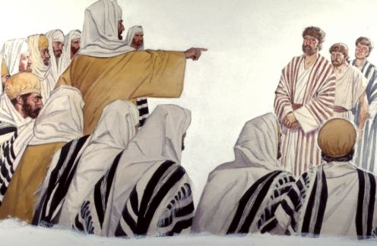
Vs. 12a
“It is those who want to make a good showing in the flesh who would force you to be circumcised...”
"The scribes and the Pharisees sit on Moses’ seat, so practice and observe whatever they tell you—but not what they do. For they preach, but do not practice. They tie up heavy burdens, hard to bear, and lay them on people’s shoulders, but they themselves are not willing to move them with their finger. They do all their deeds to be seen by others,” Matthew 23:2-5a.
You can hear the same righteous anger against such people in Paul’s tone in 5:12.
Remember in Ch 5 that we talked about freedom in Christ? Total liberty!?
Jesus says, “My yoke is easy and my burden is light,” Matthew 11:30.
We have the antithesis of what the Pharisees do in Galatians 6. Whatever yoke remains in sanctification that we struggle with is to be born by each other. 6:2. This is the law of Christ. Therefore our burdens, in a real sense, are 1) our own sin/struggles, and 2) each other’s.
Circumcision was the sign of the OT covenant. Genesis 17:10.
The NT sign of community is water baptism.
However, it was no less wrong to select circumcision as the sole identification of faithfulness over the Galatians then it is for many today who select only water baptism as the sign.
Whether it’s 1st Century or 21st Century, the Gospel is from faith to faith. JBFA.
Christ’s active obedience is why we’re saved. Not our experiences or actions!
You are not saved by what you do! John 6:63b: “The flesh [you] is [are] no help at all.”

Slide 5
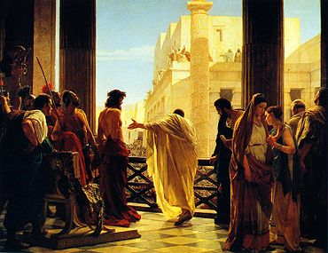
Vs 12b
“…and only in order that they may not be persecuted for the cross of Christ.”
Persecution for the cause of Christ is because of the offensive justification of faith in Christ. The Judaizers did not know it so they avoided persecution for it.
The stumbling stone is the necessity of a perfect obedience that is in another.
“But if I, brothers, still preach circumcision, why am I still being persecuted? In that case the offense of the cross has been removed,” Galatians 5:11.
You only endure this persecution if you believe it. A most common Greek word for “witness” is μαρτυρέω (martyreō). How does this word come into the English language?
“But now that you have been set free from sin and have become slaves of God, the fruit you get leads to sanctification and its end, eternal life. For the wages of sin is death, but the free gift of God is eternal life in Christ Jesus our Lord,” Romans 6:22-23.
Romans 9:30-31 quotes five OT passages saying: “What shall we say, then? That Gentiles who did not pursue righteousness have attained it, that is, a righteousness that is by faith; but that Israel who pursued a law that would lead to righteousness did not succeed in reaching that law. Why? Because they did not pursue it by faith, but as if it were based on works. They have stumbled over the stumbling stone, as it is written, “Behold, I am laying in Zion a stone of stumbling, and a rock of offense; and whoever believes in him will not be put to shame."
1. “Set free from sin”=Justification
2. Sanctification
3. Glorification

Slide 6
Vs. 13
“For even those who are circumcised do not themselves keep the law, but they desire to have you circumcised that they may boast in your flesh.”
To arbitrarily select circumcision as the mark of true faith out of the whole OT faith was ridiculous.
Even they do not obey all the law. Remember, it’s a packaged deal: “Indeed I, Paul, say to you that if you become circumcised, Christ will profit you nothing. And I testify again to every man who becomes circumcised that he is a debtor to keep the whole law,” Galatians 5:2-3.
When other people become the proof or satisfaction of your faith (your boasting) it quickly becomes very dangerous.

Slide 7
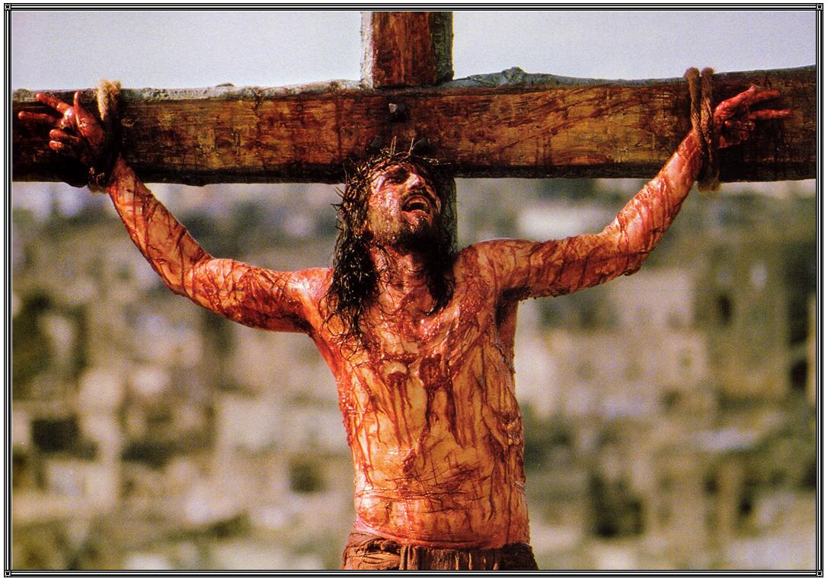
Vs. 14
“But far be it from me to boast except in the cross of our Lord Jesus Christ, by which the world has been crucified to me, and I to the world.”
Don’t confuse the good boasting and the foolish boasting.
The foolish boasting (of the Judaizers) was in their law keeping.
The good boasting of the Christian is in obedience to Christ in the power of the Holy Spirit.
“For it is God who works in you both to will and to do for His good pleasure,” Philippians 2:13.
I can boast that my sins are forgiven.
I can boast that I am a child of God.
I can boast…I have a heavenly Father.
I can boast that I have been given life.
By grace alone!
Through faith alone!
By Christ alone!
According to Scripture alone!
To the glory of God alone!

Slide 8
Self righteousness-bad Christ righteousness-good
You
Outside you
Christ
Confidence
Christianity is not self righteousness.
It is an alien righteousness. Perfect!
That is our boast all day long!
“God has chosen the foolish things of the world to put to shame the wise, and God has chosen the weak things of the world to put to shame the things which are mighty; and the base things of the world and the things which are despised God has chosen, and the things which are not, to bring to nothing the things that are, that no flesh should glory in His presence. But of Him you are in Christ Jesus, who became for us wisdom from God—and righteousness and sanctification and redemption— that, as it is written, “He who glories, let him glory in the LORD,” 1 Corinthians 1:27-31.
You
Fear
Performance
Christ

Slide 9
Vs. 15
“For neither circumcision counts for anything, nor uncircumcision, but a new creation.”
We’ve/they’ve received this admonition twice.
We got it here in direct relation to “a new creation.”
In 5:6 it was directly in regard to a “faith working through love.”
The point is here made abundantly clear through repetition. No circumcision is required Galatia! No works!. This is where grace through faith alone came from.
We are one: New creations. “Therefore, if anyone is in Christ, he is a new creation. The old has passed away; behold, the new has come. All this is from God…” 2 Corinthians 5:17-18a.
And two: at work through love: “Whoever says "I know him" but does not keep his commandments is a liar, and the truth is not in him, but whoever keeps his word, in him truly the love of God is perfected. By this we may know that we are in him: whoever says he abides in him ought to walk in the same way in which he walked. Beloved, I am writing you no new commandment…” 1 John 2:4-7a.
“Bear one another’s burdens, and so fulfill the law of Christ,” Galatians 6:2.
"This is my commandment, that you love one another as I have loved you,” John 15:2.

Slide 10
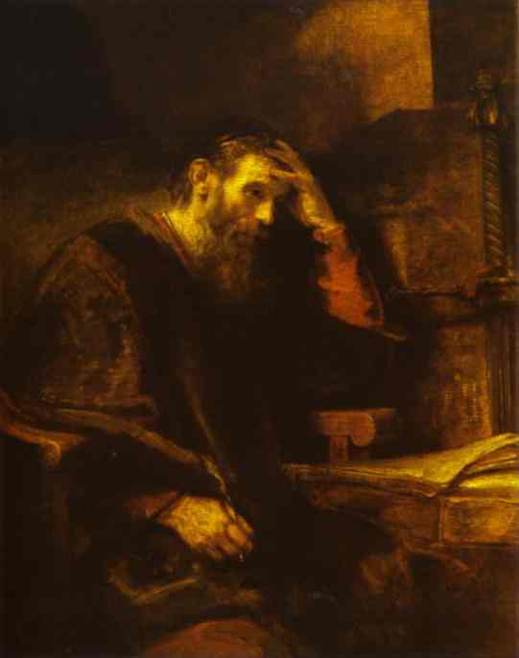
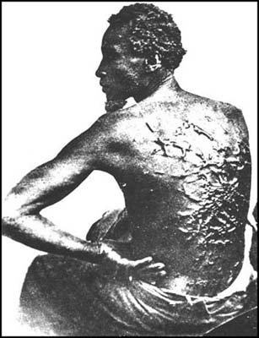
Vv. 16-18
Paul, The willing Slave
“But whatever anyone else dares to boast of—I am speaking as a fool—I also dare to boast of that. Are they Hebrews? So am I. Are they Israelites? So am I. Are they offspring of Abraham? So am I. Are they servants of Christ? I am a better one—I am talking like a madman—with far greater labors, far more imprisonments, with countless beatings, and often near death. Five times I received at the hands of the Jews the forty lashes less one. Three times I was beaten with rods. Once I was stoned. Three times I was shipwrecked; a night and a day I was adrift at sea; on frequent journeys, in danger from rivers, danger from robbers, danger from my own people, danger from Gentiles, danger in the city, danger in the wilderness, danger at sea, danger from false brothers; in toil and hardship, through many a sleepless night, in hunger and thirst, often without food, in cold and exposure. And, apart from other things, there is the daily pressure on me of my anxiety for all the churches. Who is weak, and I am not weak? Who is made to fall, and I am not indignant?” 2 Corinthians 11:21b-29.
“And as for all who walk by this rule, peace and mercy be upon them, and upon the Israel of God. From now on let no one cause me trouble, for I bear on my body the marks of Jesus. The grace of our Lord Jesus Christ be with your spirit, brothers. Amen.”
So what of those who do not walk according to this rule?
No peace upon them…right now.
“The Israel of God” statement here is not, in my understanding, to replace the nation of Israel itself. Rather, it is simply an analogous reference to the faithful.
Marks of the Lord…?
"Go, for he is a chosen instrument of mine to carry my name before the Gentiles and kings and the children of Israel. For I will show him how much he must suffer for the sake of my name, “Acts 9:15-16.
He was a servant of Jesus Christ indeed!

Slide 11
Questions
The grace of the Lord (Vs 18) is with those who have partaken of His loving grace!
May it be with us…

Slide 12
Galatians bible study is over!
See you next week to begin our study on election.
Invite a friend.
12 Aug 11

