Slide 1
Galatians Bible study

Slide 2
Galatians 4:1-3 the church’s coming of age
Review Vv 22-29, and then chapter three. Leads into chapter four.
Our text: “What I am saying is that as long as the heir is a child, he is no different from a slave, although he owns the whole estate. He is subject to guardians and trustees until the time set by the father. So also, when we were children, we were in slavery under the basic principles of the world.”
Who’s the “We” here? Can this be used in more than one way?
Let’s examine the whole theme of chapter 3:
The grace of God and the Gospel-
They received by “Hearing” and not earning. Vs. 2.
Even the miracles they’d seen were not of works, but hearing. Vs. 5.
Abraham received by believing. The promises to him were not earned/earnable. Vv. 6-9. (This is shown all throughout Abraham’s life).
It is Christ over law keeping who takes our curse. Vv. 10-14.
The Law given through Moses is not a renegotiation. Vv. 15-18.
The law lights the path to the Gospel (for all). Vv. 19-25.
I would say that vs. 14 constitutes the main passage in chapter three.
The grace of God over all is the message that begins to be laid over us all starting here in Galatians with our father Abraham. Paul sites these things to illuminate this. I hope you’re getting it.

Slide 3
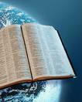
Some of the many Possible subthemes
Grace in Christ is the main theme as we saw.
Sub themes (in absolutely no particular order):
Subtheme one:
The promises and trustworthiness of God is our hope.
Subtheme two:
Beware of legalism.
Legalism is contrary to Christ’s message.
Subtheme three:
Nothing God does is pointless, even the miraculous birth of children.
Subtheme four:
Christ is the one all the prophets spoke of.
Subtheme five:
Unity of both Jew and Gentile: 3:8-9; 14; 26-28.
Unification between the Jew and Gentile.
Calvin quote. (From his commentary on Galatians, pg. 115).

Slide 4
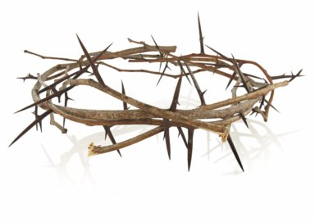
The good, the bad and the ugly
¹ What I am saying is that as long as the heir is a child, he is no different from a slave, although he owns the whole estate. ² He is subject to guardians and trustees until the time set by the father. ³ So also, when we were children, we were in slavery under the basic principles of the world. ⁴ But when the time had fully come, God sent his Son, born of a woman, born under law, ⁵ to redeem those under law, that we might receive the full rights as sons. ⁶ Because you are sons, God sent the Spirit of his Son into our hearts, the Spirit who calls out, “Abba, Father.” ⁷ So you are no longer a slave, but a son; and since you are a son, God has made you also an heir.
Remember the audience!
Jew
Gentile
Both
You means “Whoever” or “Both.”

Slide 5
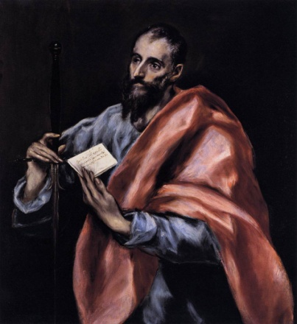
Vs. 2
“He is subject to guardians and trustees until the time set by the father.”
This is vs. 23- The Jews were directly under the law.
and vs. 22- The Gentiles were/are condemned by law (by sin) as well.
The NT faith, however, has now come and Paul is a proclaimer of it. He is making the church in Galatia aware of the grace of God that unifies them, with the Jew, under Christ by grace alone, the same grace.
Does anyone remember what verse contained the mystery we looked at in vv. 23-25 two weeks ago?
Colossians 1:26-27: “The mystery that has been kept hidden for ages and generations, but is now disclosed to the saints. To them God has chosen to make known among the Gentiles the glorious riches of this mystery, which is Christ in you, the hope of glory.”
Here’s what I think this knowledge does: Hope = the righteousness of Christ. Is it yours?
The word “Hope” is what Galatians 4:1-3 is cementing in us as we apply what we’re learning. The root word for hope in Greek is “elpizw” (elpizo) and is the same used in Romans 8:20 and God’s assurance of one day restoring all things.

Slide 6
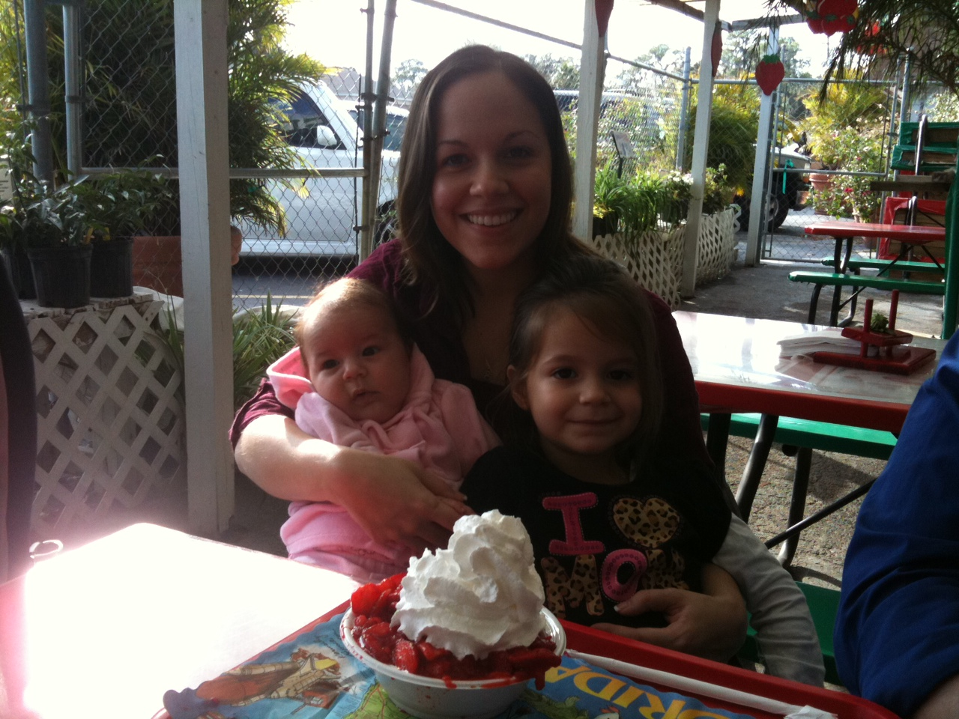
Vs. 3
“So also, when we were children, we were in slavery under the basic principles of the world.”
The other places in Scripture where I see this term “Basic principles” used are:
Colossians 2:8- “See to it that no one takes you captive through hollow and deceptive philosophy, which depends on human tradition and the basic principles of this world rather than on Christ.”
Vs. 20- “Since you died with Christ to the basic principles of this world…”
In Hebrews 5:12 he’s rebuking the people for needing “Elementary truths” again though they should be teachers. I.e. it’s back to the basics for them.
This just means they only had the shadow of the things to come. (Let me illustrate what I think the Galatians were, in effect, doing.)
This only reinforces Galatians 3:24-25.
We are no more trusting in grace than our father Abraham or any others. We are alive in an age where God has given the fullness.
“Then he turned to his disciples and said privately, “Blessed are the eyes that see what you see. For I tell you that many prophets and kings wanted to see what you see but did not see it, and to hear what you hear but did not hear it.” Luke 10:23-24.

Slide 7
Where is our hope?
The whole purpose of our understanding of grace is the exaltation of Christ.
Until you’re under the greatness of Christ it is difficult to really abandon your own self righteousness.
The Scriptures teaching on grace rips it from ourselves and places it in Christ.
We’re told we’re heirs in Galatians 3:29 and 4:7. Why are we heirs?
The main theme of the book of Hebrews is Christ’s excellence over all created things! Hebrews 8:1 says that Christ’s High Priestly office is the main point of much of it. Let’s go to Hebrews 6:13-20.

Slide 8
not us, but christ
Christians are heirs with Him because of Him

Slide 9
Galatians bible study
See you next week.
Invite a friend.
15 Apr 11

