Slide 1
Galatians Bible study

Slide 2
Galatians 3:18 The point
Moral
Ceremonial
Civil
Our text.
Review.
Moral, ceremonial & civil law in Israel, none can save.
We must trust in the promise. We will if we trust the one who promised.
Are you in the faith?
Do you trust God?

Slide 3
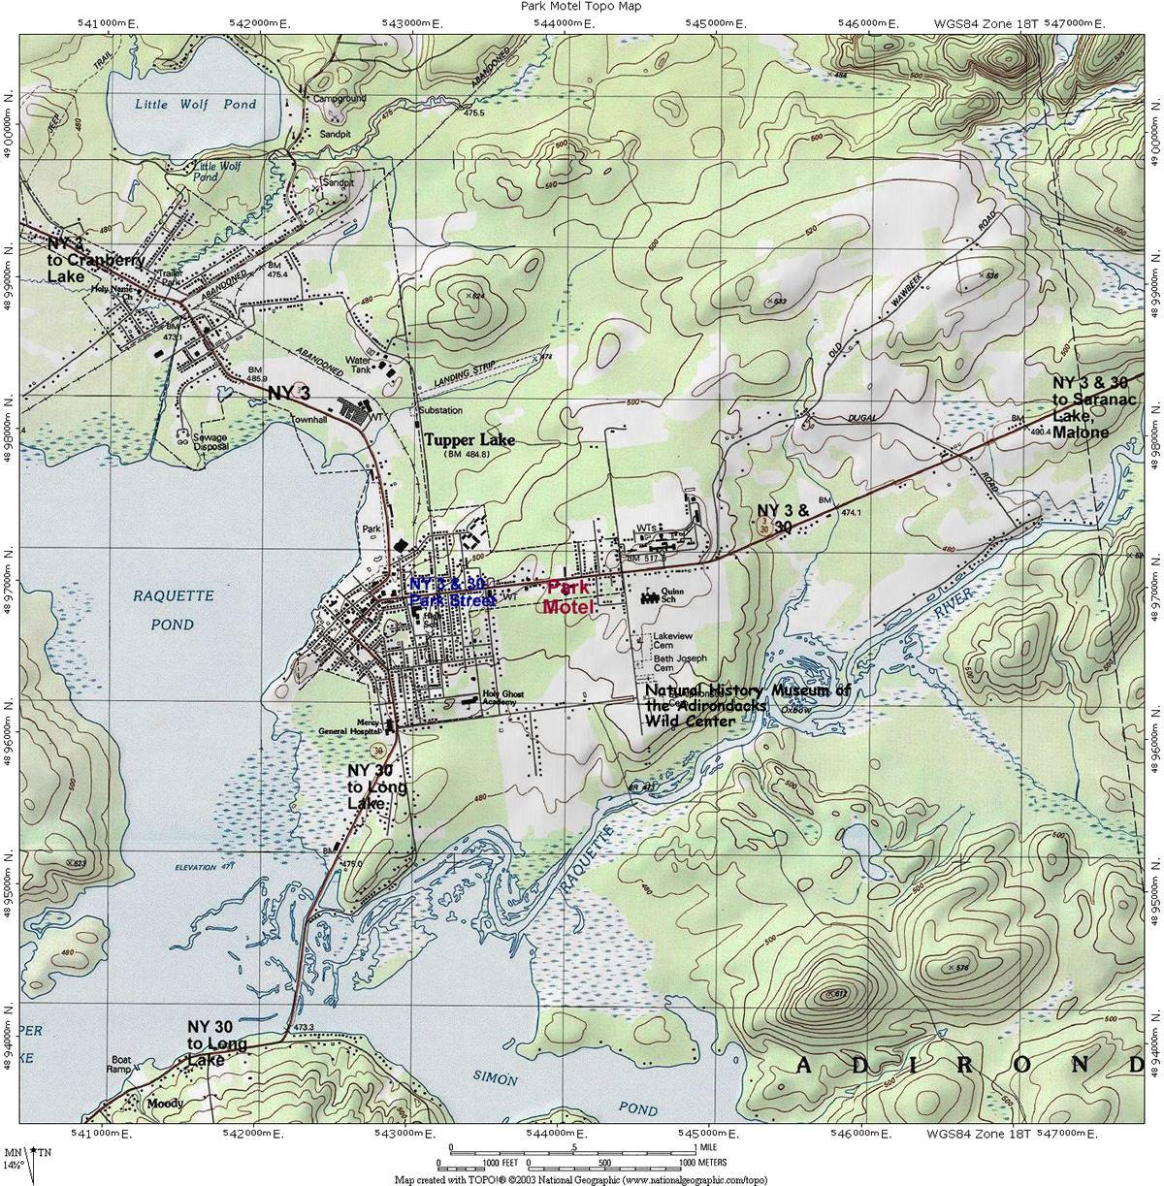
The objective
II
…
TRUST
II

Slide 4
Our life
Be ruthless against works righteousness; it distracts/detracts from grace.
Don’t let your faith be driven by works; rather, let them define in whom you trust.
Faith should be guided by a loving dependence on God.
Pray to attain the gift of this wisdom.
War against the sin of self righteousness. It leads many to hell.
Then get to work.

Slide 5
“What then shall we say that Abraham, our forefather according to the flesh, discovered in this matter?” Romans 4:1-16
Romans 4
Galatians 3
¹³ “It was not through the law that Abraham and his offspring received the promise that he would be heir of the world, but through the righteousness that comes by faith. ¹⁴ For if those who depend on the law are heirs, faith means nothing and the promise is worthless, ¹⁵ because the law brings wrath. And where there is no law there is no transgression.
¹⁶ Therefore, the promise comes by faith, so that it may be by grace and may be guaranteed to all Abraham’s offspring—not only to those who are of the law but also to those who have the faith of Abraham. He is the father of us all.”
¹⁷ “What I mean is this: The law, introduced 430 years later, does not set aside the covenant previously established by God and thus do away with the promise. ¹⁸ For if the inheritance depends on the law, then it no longer depends on the promise; but God in his grace gave it to Abraham through a promise.”.

Slide 6
Philippians 3:3-9
Vs. 3- “It is we who are the circumcision…”
An interesting use. Remember that much of the controversy was over the role of circumcision.
John 4:23: “Yet a time is coming and has now come when the true worshipers will worship the Father in spirit and truth, for they are the kind of worshippers the Father seeks.”
These verses show, in us/in the NT, the promise being fulfilled.
Whatever else it is, if it is not genuine love in your heart with God then it will not last! I guarantee it!

Slide 7
Meditate on these promises. They were made to men far better than us
Hebrews 11
John 14
VV. 8-10: “By faith Abraham, when called to go to a place he would later receive as his inheritance, obeyed and went, even though he did not know where he was going. By faith he made his home in the promised land like a stranger in a foreign country; he lived in tents, as did Isaac and Jacob, who were heirs with him of the same promise. For he was looking forward to the city with foundations, whose architect and builder is God.”
VV. 1-4: “Do not let your hearts be troubled. Trust in God; trust also in me. In my Father’s house are many rooms; if it were not so, I would have told you. I am going there to prepare a place for you. And if I go and prepare a place for you, I will come back and take you to be with me that you also may be where I am. You know the to the place where I am going.”

Slide 8
We are saved by works… just not our own!
“I tell you the truth, whoever hears my word and believes him who sent me has eternal life and will not be condemned; he has crossed over from death to life.”… “Your father Abraham rejoiced at the thought of seeing my day; he saw it and was glad.” John 5:24; 8:56.
.
By grace alone!
Through faith alone!

Slide 9
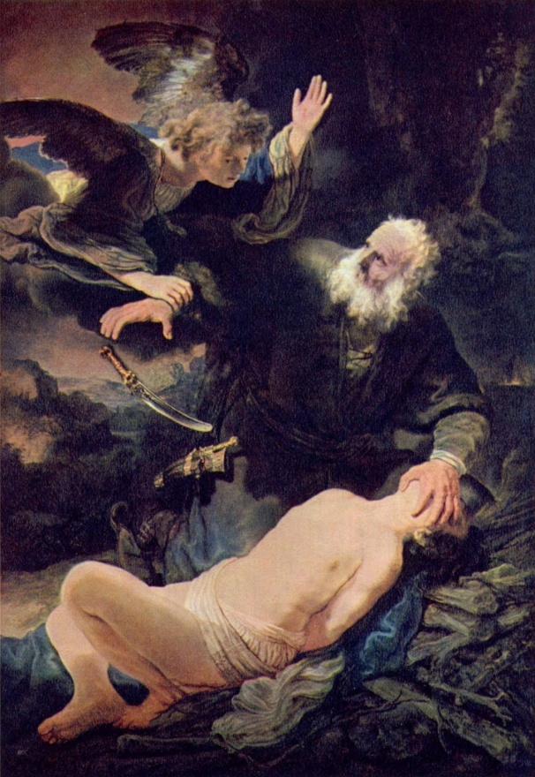
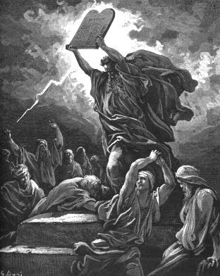
The promise
teaches
us this.
The Law will
teach us
this as well.
Galatians
3:6-18
Galatians 3:19-25

