Slide 1
WELCOME TO
ALL NATIONS CHAPEL
3 JULY 2011

Slide 2
ALL NATIONS CHAPEL & ANNEX (EAST SIDE)
54th EN
2-10 AVN
Upcoming Special Events
Chapel Services
Protestant SVC Gospel SVC | SUN 1030 SUN 1915
Catholic Mass | AS ANNOUNCED UNTIL WE HAVE A PRIEST.
Baptism Service at 1900 | 17 JULY
9/11 Memorial SVC at 1700 | 11 SEP
Chaplain Studies
For More Information Contact:
CH (CPT) Robinson, PFC Vines
(54th EN)
481-5025/5026
CH (CPT-P) Johnson, SPC Macalpin
(2-10 AVN)
481-5265
Gospel of John Study | WED 1900
Book of Galatians | FRI 2000
Five Love Languages/Song of Solomon (Marriage Training) | SAT 2000 (Begins 16 JULY)
Sign Up Now!
CH Johnson will be teaching a University of Maryland Europe World Religion Class in the All Nations Chapel on MON, WED, AND FRI Nights beginning 11 JUL, through 15 AUG. Go to the Education Center and see Mr. Turpin for information. GO Army ED #126202, Section #53766. THIS SCHEDULE TAKES EFFECT ON 19 JUNE.

Slide 3
OUTLIVE YOUR LIFE: YOU WERE MADE TO MAKE A DIFFERENCE (By Max Lucado)
ALL NATIONS CHAPEL PREACHING SERIES
1030 SUNDAY PROTESTANT SERVICE
1 MAY – 21 AUGUST, 2011
1 MAY “Our Once in History Opportunity” Acts 13:36
8 MAY “Calling Mr. Pot Roast” Acts 1:8
15 MAY “Let God Unshell You” Acts 2:11
22 MAY “Don’t Forget the Bread” Acts 2:38-39
29 MAY “Team Up” Acts 2:44
5 JUNE “Open the Door; Open Your Heart” Acts 2:46
12 JUNE “See the Need: Touch the Hurt” Acts 3:4-7
19 JUNE “Persecution: Prepare for It; Resist It” Acts 4:1
26 JUNE “Do Good, Quietly” Acts 5:1-2
3 JULY Patriotic Theme for Independence Day in the U.S.
10 JULY “Stand Up for the Have-Nots” Acts 6:1
17 JULY “Remember Who Holds You” Acts 7:49-50
24 JULY “Blast a Few Walls” Acts 8:36-37
31 JULY “Don’t Write Off Anyone” Acts 9:17
7 AUG “Stable the High Horse” Acts 10:28
14 AUG “Pray First, Pray Most” Acts 12:5
21 AUG “That’s Jesus Playing That Fiddle” Matthew 25:31-46

Slide 4
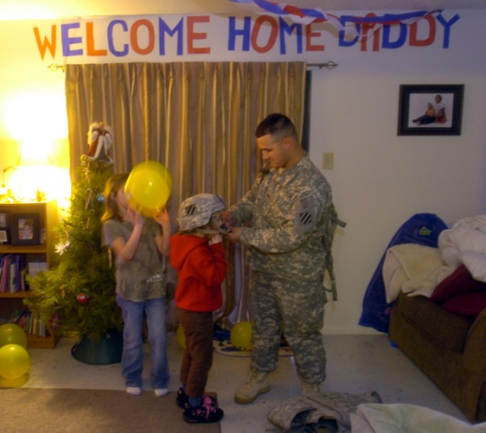
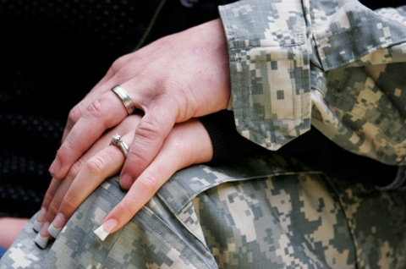
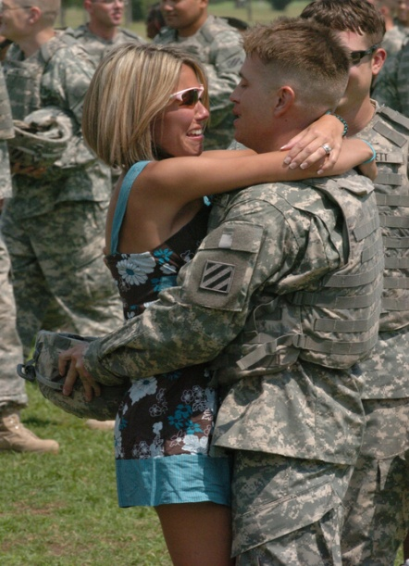
A FINAL OPPORTUNITY
to make things
better at HOME
The Five Love Languages &
The Song of Solomon
Marriage Workshop @
All Nations Chapel Annex
Starts 16 JUL 2000L to 2100L,
for 8 Saturdays
“How do we meet each other’s deep emotional need to feel loved? If we can learn that and choose to do it, then the love we share will be exciting beyond anything we ever felt when we were infatuated.”
Dr. Gary Chapman
Free 5 Love Languages Book (For 1st 20)
Watch Accompanying Videos
The secret to love that lasts
Know your spouse better
Profiles for husbands & wives
Prepare for Reintegration
Tommy Nelson’s “Song of
Solomon” 11 Part Video Study
on courtship, companionship,
and true marital intimacy.
POC: CH (CPT-P) Jerry Johnson
Task Force Knighthawk Chaplain
DSN 481-5265
Sign Up by e-mailing him on Outlook

Slide 5
WELCOME PRAYER –
CPT Pittano

Slide 6
WORSHIP SONG –

Slide 7
We Fall Down
We fall down, we lay our crowns at the feet of Jesus.
The greatness of His mercy and love, at the feet of Jesus
We cry Holy, Holy, Holy
We cry Holy, Holy, Holy
We cry Holy, Holy, Holy is the Lamb

Slide 8
No more fears, You've dried our tears at the feet of Jesus.
Grace abounds to all who've found the feet of Jesus.

Slide 9
We cry Holy, Holy, Holy
We cry Holy, Holy, Holy
We cry Holy, Holy, Holy is the Lamb
We cry Holy, Holy, Holy
We cry Holy, Holy, Holy
We cry Holy, Holy, Holy is the Lamb

Slide 10
PASTORAL PRAYER -
TESTIMONIES AND
SPECIAL REQUESTS
(CPT PITTANO)

Slide 11
WORSHIP SONG –
WORSHIP SONG –

Slide 12
Mighty to Save
Everyone needs compassion
A love that’s never failing.
Let mercy fall on me.
Everyone need's forgiveness,
The kindness of a Savior,
The hope of nations.

Slide 13
Savior, He can move the mountains.
My God is mighty to save,
He is mighty to save.
Forever, Author of Salvation,
He rose and conquered the grave,
Jesus conquered the grave

Slide 14
So take me as you find me,
All my fears and failures,
And fill my life again.
I give my life to follow
Everything I believe in,
Now I surrender.

Slide 15
Shine your light and let the whole world see, singin'
For the glory of the risen King, Jesus.

Slide 16
WORSHIP SONG –

Slide 17
Word of God Speak
I'm finding myself at a loss for words,
And the funny thing is, it's ok.
The last thing I need, is to be heard.
But to hear, what you would say.

Slide 18
Word of God speak.
Would You pour down like rain.
Washing my eyes to see Your majesty.
To be still and know that You're in this place.
Please let me stay and rest
In your holiness, word of God speak.

Slide 19
I'm finding myself in the midst of You.
Beyond the music, beyond the noise.
All that I need is to be with You.
And in the quiet, to hear Your voice.

Slide 20
Word of God speak.
Would You pour down like rain.
Washing my eyes to see Your majesty.
To be still and know that You're in this place.
Please let me stay and rest
In your holiness, word of God speak.

Slide 21
WORSHIP SONG –
WORSHIP SONG –

Slide 22
Majesty (here I am)
Here I am, humbled by Your majesty, covered by your grace so free.
Here I am, knowing that I'm a sinful man, covered by the blood of the Lamb.
Now I've found, the greatest love of all is mine. Since You laid down Your life, the greatest sacrifice

Slide 23
Majesty, Majesty-Your grace has found me just as I am.
Empty handed but alive in Your hands.
Majesty, Majesty-Forever I am changed by Your love, In the presence of Your majesty.

Slide 24
Here I am, humbled by the love that You give, forgiven so that I can forgive.
Here I stand, knowing that I'm Your desire, sanctified by glory and fire.
Now I've found, the greatest love of all is mine. Since You laid down Your life, the greatest sacrifice.

Slide 25
Majesty, Majesty-Your grace has found me just as I am.
Empty handed but alive in Your hands.
Majesty, Majesty-Forever I am changed by Your love, In the presence of Your majesty.

Slide 26
4th of July Message
“Dependence Day 1,496,684! Yeah!”
CPT Joseph Pittano
www.Biblecia.com
(Shameless plug)

Slide 27
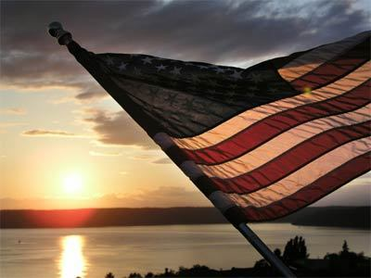

Slide 28
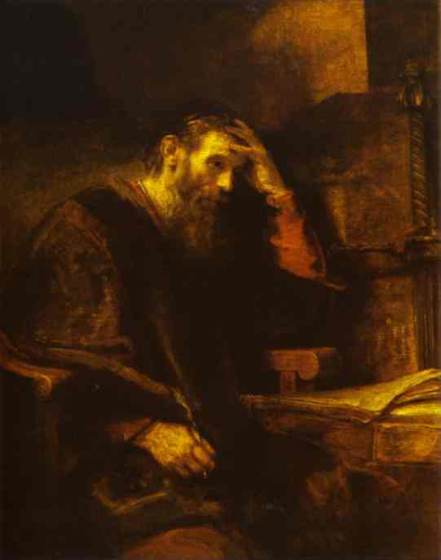
OUR PASSAGE
“UNLESS THE LORD OF SABAOTH HAD LEFT TO US A POSTERITY, WE WOULD HAVE BECOME LIKE SODOM, AND WOULD HAVE RESEMBLED GOMORRAH,” Romans 9:29. (NASB here and throughout).
What’s worse- a nation under the oppression of another, or a people under the oppression of sin?

Slide 29
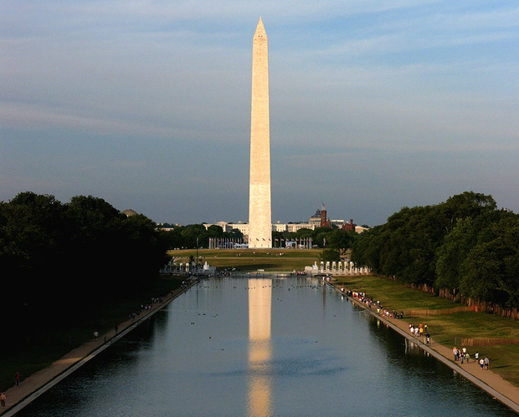
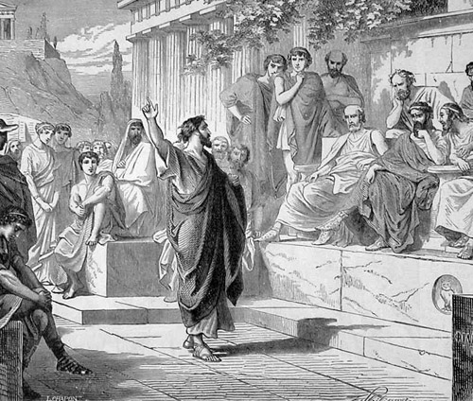
God makes nations and brings them down
“So Paul stood in the midst of the Areopagus and said, “Men of Athens, I observe that you are very religious in all respects. For while I was passing through and examining the objects of your worship, I also found an altar with this inscription, ‘TO AN UNKNOWN GOD.’ Therefore what you worship in ignorance, this I proclaim to you. The God who made the world and all things in it, since He is Lord of heaven and earth, does not dwell in temples made with hands; nor is He served by human hands, as though He needed anything, since He Himself gives to all people life and breath and all things; and He made from one man every nation of mankind to live on all the face of the earth, having determined their appointed times and the boundaries of their habitation, that they would seek God, if perhaps they might grope for Him and find Him, though He is not far from each one of us; for in Him we live and move and exist,” Acts 17:22-28.

Slide 30
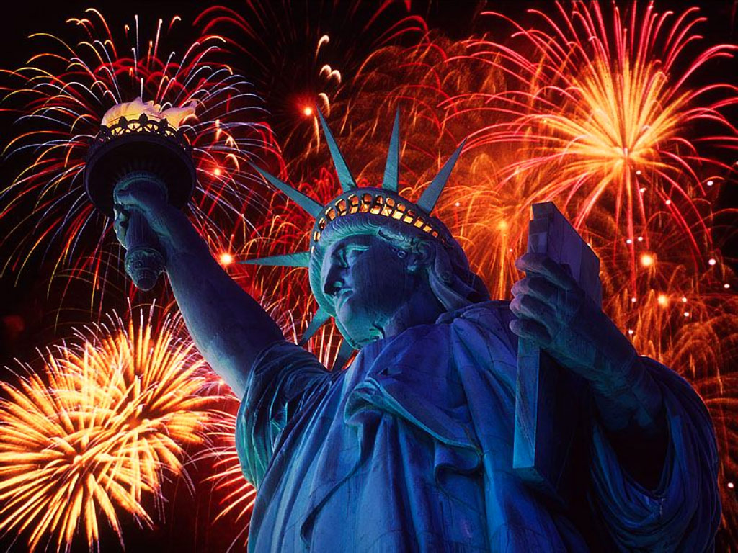
Romanticizing the American Ideal
I find myself idealizing America.
Secularism has done its work among us.
We are an all roads lead to God kind of people.
Privilege has become right.
I look around at a FOB of thousands and see dozens.
I’m tempted here to sometimes believe that God failed.
Then I remember Paul’s day.
And how he bid me to remember Elijah’s day.

Slide 31
Romanticizing the Church?
What worries me most is the church!
Homosexuality.
Feminism.
Pluralism.
Division.
Weakness.
Prosperity “gospel” preachers/self-help-ology.

Slide 32
Conclusion
Christianity is a culture invading faith.
In our homes let’s teach our children about God.
In our jobs let’s be witnesses for Christ.
In our actions let’s honor Christ.
Serve one another.
Look around. Take in Afghanistan. Remember the God who put your feet where they are in your own land.
It is God and God alone who preserves us, even us.
What about our children and our children’s children?

Slide 33
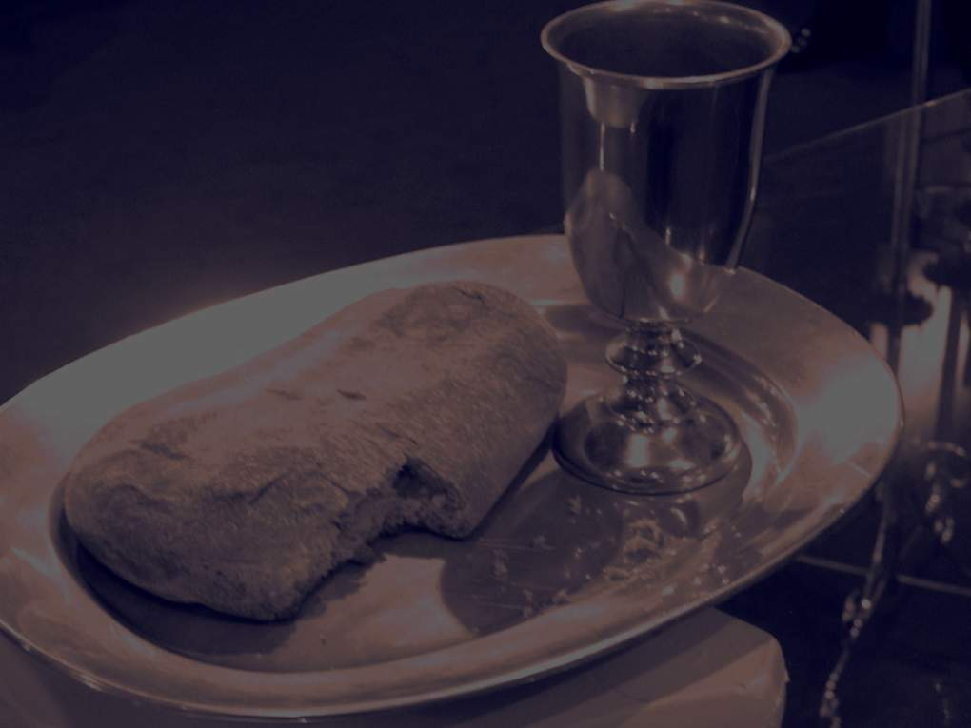
THE LORD’S SUPPER
CH ROBINSON

Slide 34
CLOSING SONG –

Slide 35
Sanctuary
Lord, prepare me to be a sanctuary
Pure and holy, tried and true
With thanksgiving, I'll be a living
Sanctuary for you.
It is You, Lord, who came to save
The heart and soul of every man.
It is you, Lord, who knows my weakness,
Who gives me strength with Thine own hand.

Slide 36
Lead me on, Lord, from temptation,
Purify me from within.
Fill my heart with your Holy Spirit,
Take away all my sin.
Lord, prepare me to be a sanctuary
Pure and holy, tried and true
With thanksgiving, I'll be a living
Sanctuary for you.

Slide 37
BENEDICTION –
CPT PITTANO

