Slide 1
WELCOME TO
ALL NATIONS CHAPEL
12 JUNE 2011
FAREWELL TO
CH JOHNSON &
1SG KOLODGY
FOR R&R

Slide 2
ALL NATIONS CHAPEL & ANNEX (EAST SIDE)
54th EN
2-10 AVN
Upcoming Special Events
Chapel Services
Protestant SVC Gospel SVC | SUN 1030 SUN 1915
Catholic Mass | AS ANNOUNCED UNTIL WE HAVE A PRIEST.
Baptism Service at 1800 | 17 JULY
9/11 Memorial SVC at 1700 | 11 SEP
Chaplain Studies
For More Information Contact:
CH (CPT) Robinson, PFC Vines
(54th EN)
481-5025/5026
CH (CPT-P) Johnson, SPC Macalpin
(2-10 AVN)
481-5265
Gospel of John Study | WED 1900
Book of Galatians | FRI 2000
Five Love Languages/Song of Solomon (Marriage Training) | SAT 2000 (Begins 16 JULY)
Sign Up Now!
CH Johnson will be teaching a University of Maryland Europe World Religion Class in the All Nations Chapel on MON, WED, AND FRI Nights beginning 11 JUL, through 15 AUG. Go to the Education Center and see Mr. Turpin for information. GO Army ED #126202, Section #53766. THIS SCHEDULE TAKES EFFECT ON 19 JUNE.

Slide 3
OUTLIVE YOUR LIFE: YOU WERE MADE TO MAKE A DIFFERENCE (By Max Lucado)
ALL NATIONS CHAPEL PREACHING SERIES
1030 SUNDAY PROTESTANT SERVICE
1 MAY – 21 AUGUST, 2011
1 MAY “Our Once in History Opportunity” Acts 13:36
8 MAY “Calling Mr. Pot Roast” Acts 1:8
15 MAY “Let God Unshell You” Acts 2:11
22 MAY “Don’t Forget the Bread” Acts 2:38-39
29 MAY “Team Up” Acts 2:44
5 JUNE “Open the Door; Open Your Heart” Acts 2:46
12 JUNE “See the Need: Touch the Hurt” Acts 3:4-7
19 JUNE “Persecution: Prepare for It; Resist It” Acts 4:1
26 JUNE “Do Good, Quietly” Acts 5:1-2
3 JULY Patriotic Theme for Independence Day in the U.S.
10 JULY “Stand Up for the Have-Nots” Acts 6:1
17 JULY “Remember Who Holds You” Acts 7:49-50
24 JULY “Blast a Few Walls” Acts 8:36-37
31 JULY “Don’t Write Off Anyone” Acts 9:17
7 AUG “Stable the High Horse” Acts 10:28
14 AUG “Pray First, Pray Most” Acts 12:5
21 AUG “That’s Jesus Playing That Fiddle” Matthew 25:31-46

Slide 4
ALL NATIONS CHAPEL ANNEX SUNDAY VIDEO BIBLE STUDIES 1 MAY – 12 JUNE 1800 ON SUN NIGHTS BEFORE GOSPEL SVC
“BUILDING A CHRISTIAN CONSCIENCE”
R.C. SPROUL
TONIGHT WE FINISH UP
THIS SERIES AT 1800!
P.O.C. IS CH JOHNSON, 481-5265

Slide 5
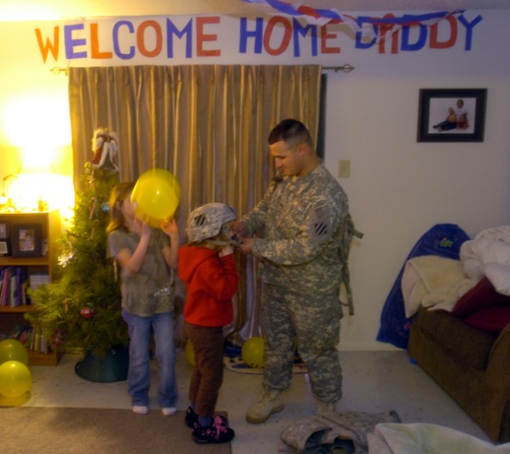
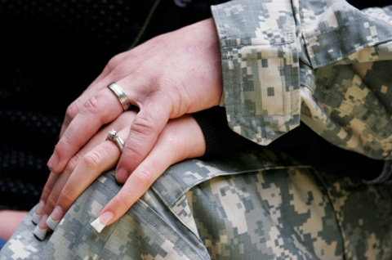
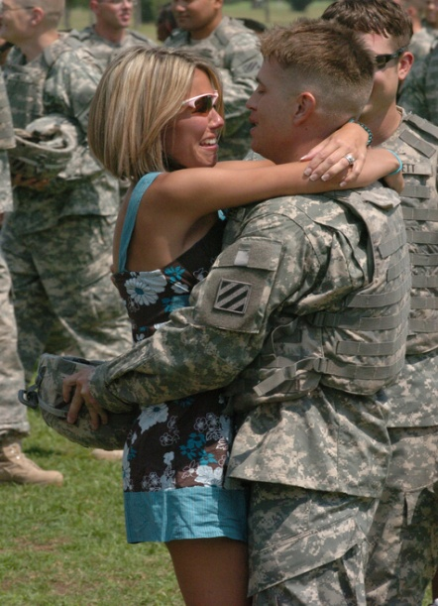
A FINAL OPPORTUNITY
to make things
better at HOME
The Five Love Languages &
The Song of Solomon
Marriage Workshop @
All Nations Chapel Annex
Starts 16 JUL 2000L to 2100L,
for 8 Saturdays
“How do we meet each other’s deep emotional need to feel loved? If we can learn that and choose to do it, then the love we share will be exciting beyond anything we ever felt when we were infatuated.”
Dr. Gary Chapman
Free 5 Love Languages Book (For 1st 20)
Watch Accompanying Videos
The secret to love that lasts
Know your spouse better
Profiles for husbands & wives
Prepare for Reintegration
Tommy Nelson’s “Song of
Solomon” 11 Part Video Study
on courtship, companionship,
and true marital intimacy.
POC: CH (CPT-P) Jerry Johnson
Task Force Knighthawk Chaplain
DSN 481-5265
Sign Up by e-mailing him on Outlook

Slide 6
WELCOME PRAYER –
CH JOHNSON

Slide 7
WORSHIP SONG –

Slide 8
ACTS 3:1-10 (ESV)
¹Now Peter and John were going up to the temple at the hour of prayer, the ninth hour. ²And a man lame from birth was being carried, whom they laid daily at the gate of the temple that is called the Beautiful Gate to ask alms of those entering the temple. ³Seeing Peter and John about to go into the temple, he asked to receive alms. ⁴And Peter directed his gaze at him, as did John, and said, "Look at us." ⁵And he fixed his attention on them, expecting to receive something from them.

Slide 9
ACTS 3:1-10 (ESV)
⁶But Peter said, "I have no silver and gold, but what I do have I give to you. In the name of Jesus Christ of Nazareth, rise up and walk!" ⁷And he took him by the right hand and raised him up, and immediately his feet and ankles were made strong. ⁸And leaping up he stood and began to walk, and entered the temple with them, walking and leaping and praising God. ⁹And all the people saw him walking and praising God, ¹⁰and recognized him as the one who sat at the Beautiful Gate of the temple, asking for alms. And they were filled with wonder and amazement at what had happened to him.

Slide 10
PASTORAL PRAYER -
TESTIMONIES AND
SPECIAL REQUESTS

Slide 11
WORSHIP SONG –
WORSHIP SONG –

Slide 12
WORSHIP SONG –

Slide 13
WORSHIP SONG –
WORSHIP SONG –

Slide 14
MESSAGE –
“SEE THE NEED;
TOUCH THE HURT”
ACTS 3:4-7
CPT JOE PITTANO
FUTURE CHAPLAIN ☺

Slide 15
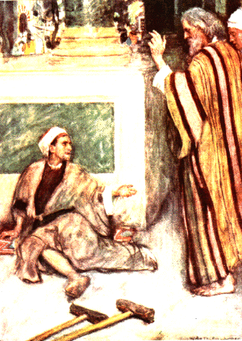
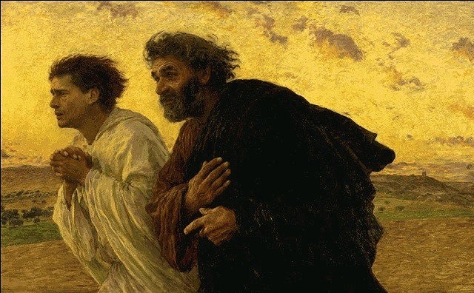
John and Peter

Slide 16
Introduction
“A gate called beautiful. The man was anything but.”
This is during the hey-day of the church.
The Scriptures record that the church was selling their goods, living in one accord under the teaching of the Apostles, and enjoying the favor of all the people.
This was an opportune place to beg.
Jewish
prayer
times
0900
3rd hour
1200
6th hour
1500
9th hour

Slide 17
Matthew 25:31-46
Notes:
Pg. 169 of Lucado’s book I feel contains the main impetus of the book.

Slide 18
Acts 3:4-5
“And Peter directed his gaze at him, as did John, and said, "Look at us." And he fixed his attention on them, expecting to receive something from them.”
He did NOT expect what he got.
The world leaves us lame, blind and def. But God has come and in Christ has given us what we would never have expected.
Scripture says that God, “…is able to do far more abundantly than all that we ask or think, according to the power at work within us,” Ephesians 3:20.
We definitely see that here.
So maybe you don’t pick up crippled people.
Would it be any less of a miracle for them if you were that person God sent to bless them?
There is great poverty in the world and you really can do miracles.
We’re the richest people on earth.
Do you think you need a lot?
Do you think you’d do more if you had a lot?

Slide 19
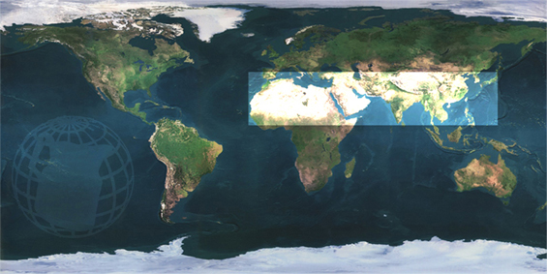
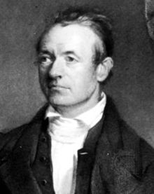
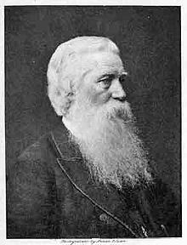
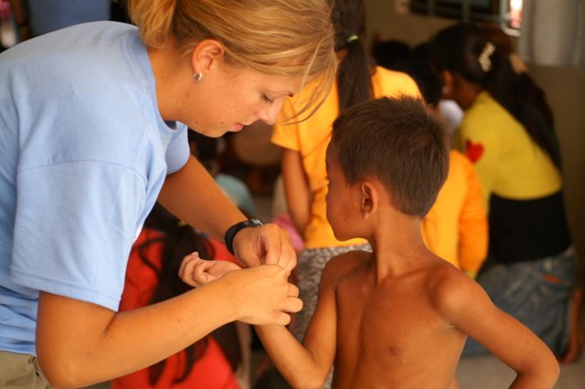
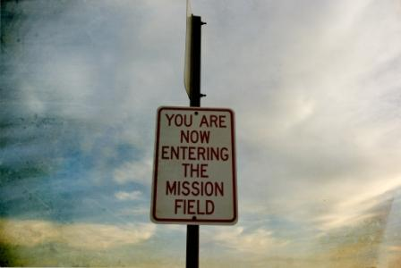
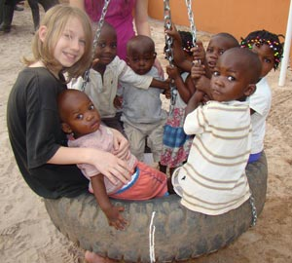
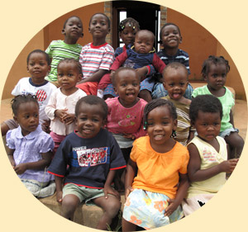
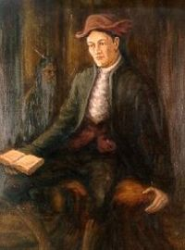
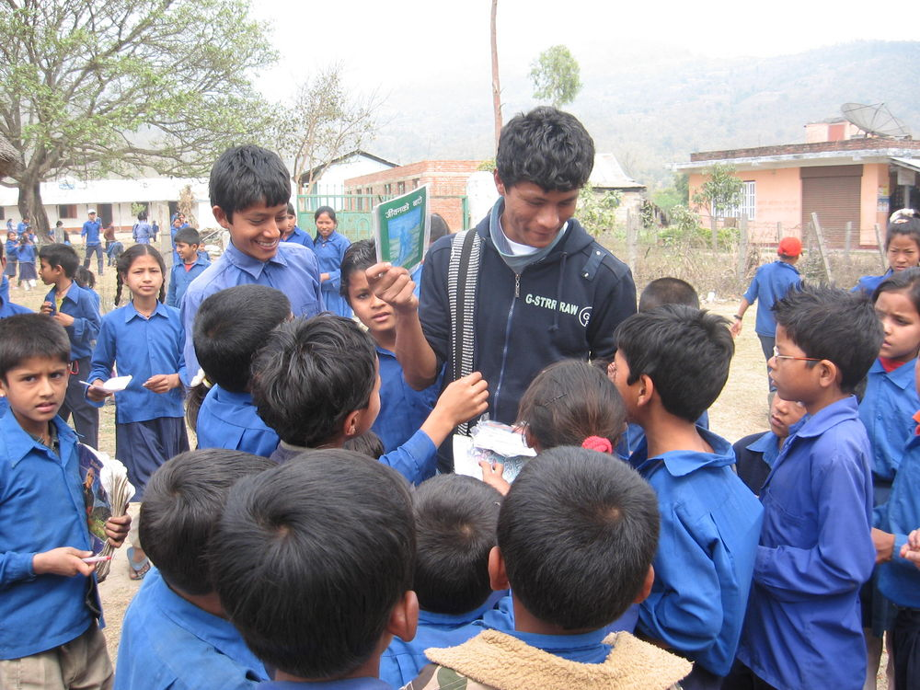
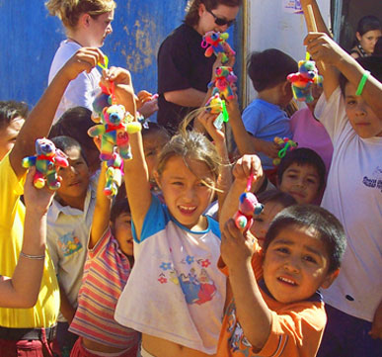

Slide 20
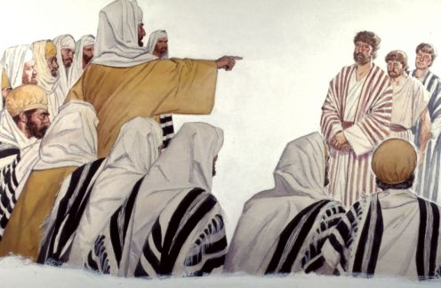
Vv 6-7
“For by grace you have been saved through faith. And this is not your own doing; it is the gift of God, not a result of works, so that no one may boast.”---For we are his workmanship, created in Christ Jesus for good works, which God prepared beforehand, that we should walk in them.”
Example: “But Peter said, "I have no silver and gold, but what I do have I give to you. In the name of Jesus Christ of Nazareth, rise up and walk!" And he took him by the right hand and raised him up, and immediately his feet and ankles were made strong.”
Imagine the joy that Peter and John must have felt that night as they laid their heads down?
There’s great joy that comes with serving.

Slide 22
The Greatest Gift
God once asked Moses, "Who has made man’s mouth? Who makes him mute, or deaf, or seeing, or blind? Is it not I, the LORD?” Exodus 4:11.
“For you always have the poor with you, and whenever you want, you can do good for them…” Mark 14:7.
Not always, but you can often estimate the value of a gift by its cost.
“To create God only had to speak; to redeem He had to suffer.” -D.L. Moody
This man’s healing in Acts three was awesome.
The gift of regeneration is a miracle working act no less powerful than the creation of the cosmos.
What did salvation cost?

Slide 23
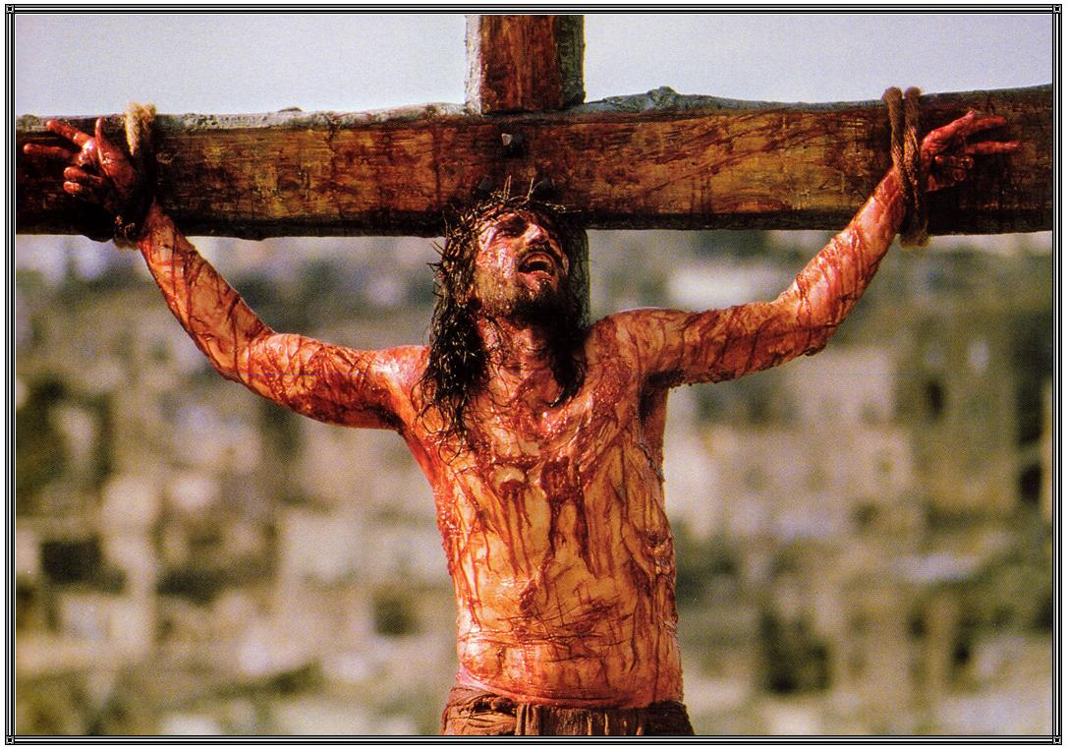

Slide 24
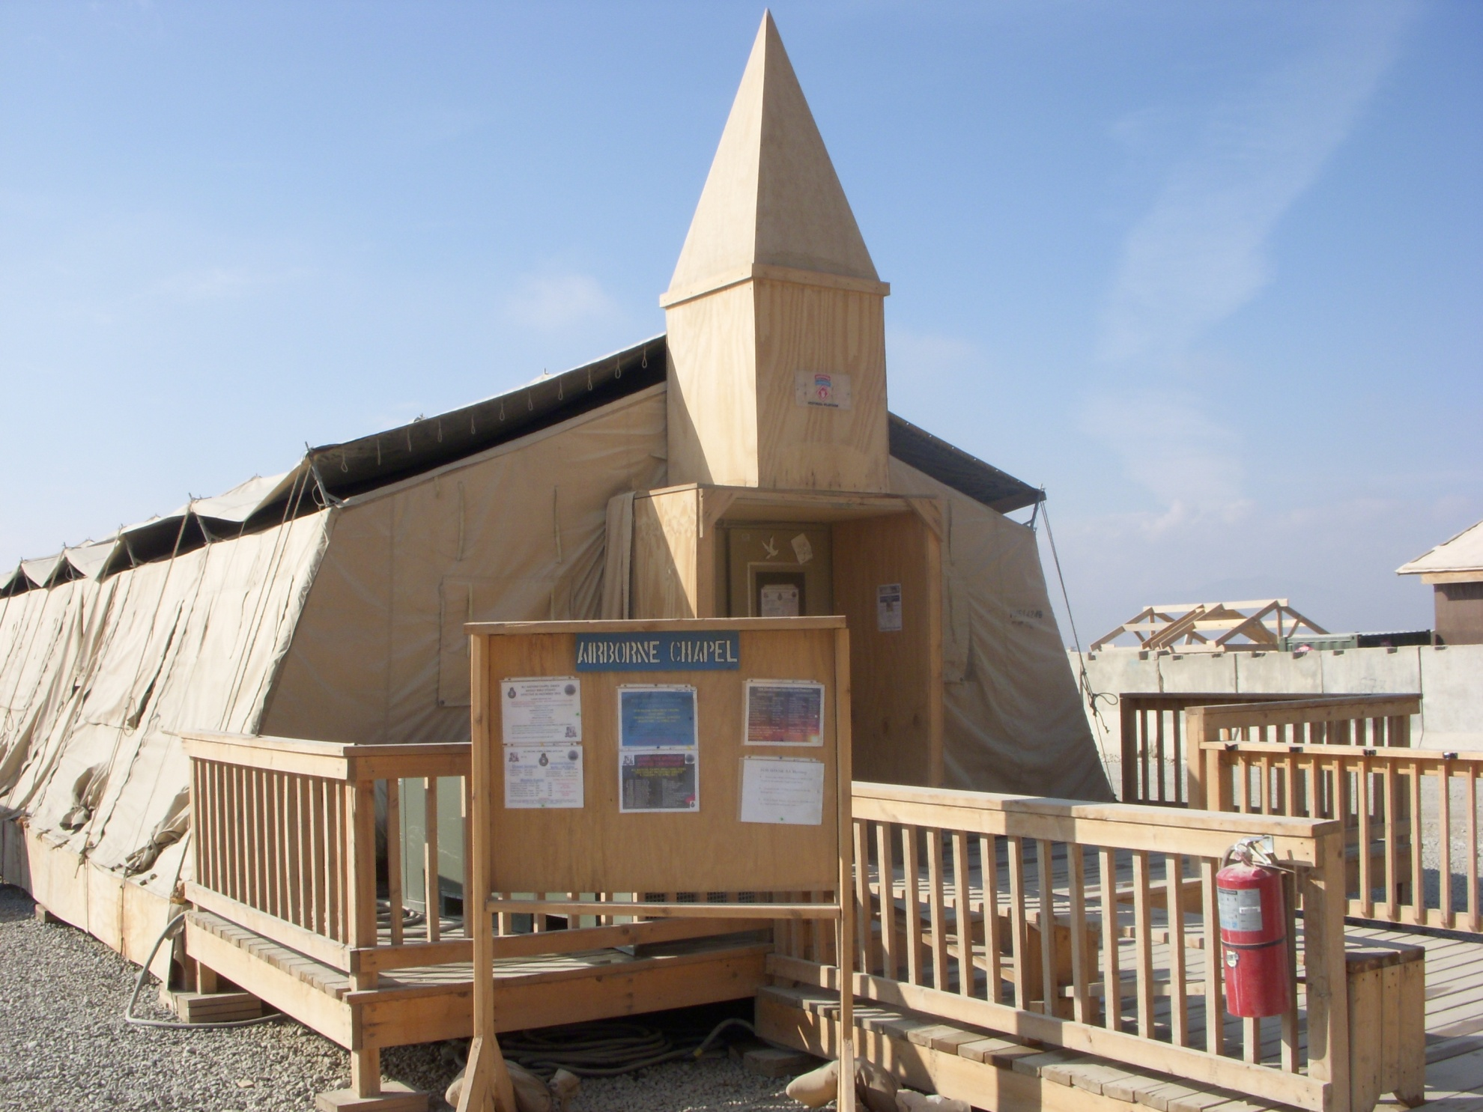

Slide 25
CLOSING SONG –

Slide 26
BENEDICTION –
CH JOHNSON

