Slide 1
WELCOME TO
ALL NATIONS CHAPEL
10 APRIL 2011

Slide 2
ALL NATIONS CHAPEL & ANNEX (EAST SIDE)
54th EN
2-10 AVN
Upcoming Teaching Series – SAT Nights
Chapel Services
Protestant SVC Gospel SVC | SUN 1030 SUN 1915
Catholic Mass | AS ANNOUNCED UNTIL WE HAVE A PRIEST.
The Seven Principles for Making Marriage Work | 30 APR – 11 JUN
The Five Love Languages | Begins 16 JUL
Chaplain Studies
For More Information Contact:
CH (CPT) Robinson, PFC Vines
(54th EN)
481-5025/5026
CH (CPT-P) Johnson, SPC Macalpin
(2-10 AVN)
481-5265
Gospel of John Study - Annex | WED 1900
Book of Galatians – Annex | FRI 2000
R. C. Sproul Video Study - Annex | SUN 1730
Sign Up Now!
CH Johnson will be teaching a University of Maryland Europe World Religion Class in the Education Center on TUE & THU nights, 2000-2300; SPRING SESSION #2, 22 MAR – 12 MAY. 3 Semester Hours College Credit. Go Army Ed #185480.
THIS SCHEDULE TAKES EFFECT 4 MARCH, 2011.

Slide 3
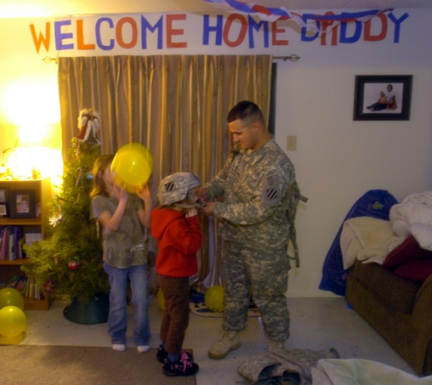
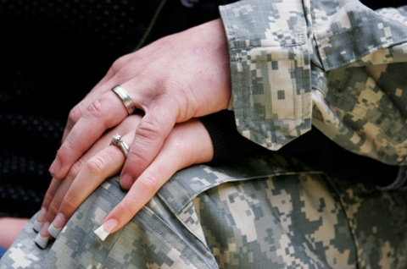
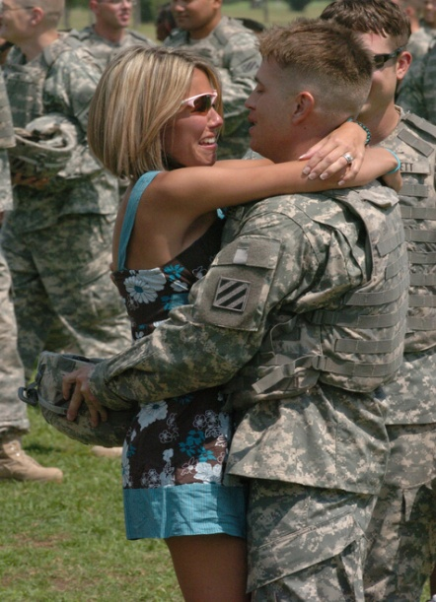
An OPPORTUNITY
to make things
better at HOME
Marriage Workshop @
All Nations Chapel Annex
Starts 30 APR 2000L to 2100L, for 7 Saturdays
“Strengthening the core of your marriage”
“Know your spouse better”
Assignments for couples while Deployed
Prepare for Reintegration
“I can tell 96 percent of the time whether a marital discussion will resolve a conflict, after the first 3 minutes of that discussion”
Dr. John Gottman
“The Seven Principles for Making Marriage Work”
(Book & Video Series)
[PREVIOUSLY SCHEDULED FOR FRIDAYS, CHANGED SO PARTICIPANTS CAN GO TO FRIDAY NIGHT PROGRAMS IF THEY DESIRE]
POC: CH (CPT-P) Jerry Johnson
Task Force Knighthawk Chaplain
DSN 481-5265
Sign Up by e-mailing him on Outlook

Slide 4
ALL NATIONS CHAPEL & ANNEX (EAST SIDE)
54th EN
2-10 AVN
SPECIAL EASTER MOVIE
“THE PASSION OF THE CHRIST”
SUNDAY NIGHT
24 APRIL, 2011, 1930
Other Holy Week Events –
Protestant Good Friday SVC – 22 APR, 1200
Ecumenical Easter Sunrise SVC – 24 APR, 0630
Catholic Masses – Look for Flyers
(NO 1030 OR 1915 SVC ON EASTER SUNDAY)

Slide 5
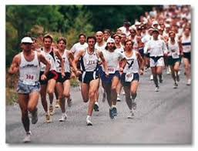
TF KNIGHTHAWK/10TH CAB “HALF WAY HOME” 5K/10K/HALF MARATHON SATURDAY, 30 APRIL, START TIME 0800
SIGN UP BY E-MAILING OR CALLING 1SG JOHN KOLODGY (481-5259) OR CH (CPT-P) JERRY JOHNSON (481-5265) FOR REGISTRATION DETAILS. PLEASE REGISTER BY 1 APRIL.
COST IS A DONATION TO THE WARRIOR SUPPORT FUND, E-5 & BELOW $5, E-6 & ABOVE $10, PAYABLE TO THE 2-10 AVN CHAPLAIN ASSISTANT SPC MACALPIN IF YOU PAY IN ADVANCE, OR ON RACE DAY.
HALF MARATHONERS WILL RECEIVE USO T-SHIRTS; 5K/10K RUNNERS WILL HAVE T-SHIRTS ORDERED IF WE RUN OUT.
ORIGINALLY SCHEDULED FOR 23 APRIL, NOW SYNCHED WITH 10TH CAB RACES AT FORT DRUM AND IN THEATER.

Slide 6
JAMES: THE EPISTLE OF APPLIED CHRISTIANITY
ALL NATIONS CHAPEL PREACHING SERIES
1030 SUNDAY PROTESTANT SERVICE
9 JANUARY – 10 APRIL, 2011
9 JAN – James 1:1-12 Trials
16 JAN – James 1:13-18 Tests of Faith
23 JAN – James 1:19-27 Obeying God’s Word
30 JAN – James 2:1-13 Faith and the Law
6 FEB – James 2:14-26 Faith and Works
13 FEB – “I Loved You When” Valentine Theme
20 FEB – James 3:1-12 The Tongue
27 FEB – James 3:13-18 Earthly vs. Heavenly Wisdom
6 MAR – James 4:1-12 The Source of Quarrels
13 MAR – James 4:13-17 Divine Providence
20 MAR – James 5:1-6 Judgment on the Rich
27 MAR – James 5:7-11 Being Patient
3 APR – James 5:12 Keeping Your Word
10 APR – James 5:13-20 Effective Prayer

Slide 7
OUTLIVE YOUR LIFE: YOU WERE MADE TO MAKE A DIFFERENCE (By Max Lucado)
ALL NATIONS CHAPEL PREACHING SERIES
1030 SUNDAY PROTESTANT SERVICE
1 MAY – 14 AUGUST, 2011
1 MAY “Our Once in History Opportunity” Acts 13:36
8 MAY “Calling Mr. Pot Roast” Acts 1:8
15 MAY “Let God Unshell You” Acts 2:11
22 MAY “Don’t Forget the Bread” Acts 2:38-39
29 MAY “Team Up” Acts 2:44
5 JUNE “Open the Door; Open Your Heart” Acts 2:46
12 JUNE “See the Need: Touch the Hurt” Acts 3:4-7
19 JUNE “Persecution: Prepare for It; Resist It” Acts 4:1
26 JUNE “Do Good, Quietly” Acts 5:1-2
3 JULY Patriotic Theme for Independence Day in the U.S.
10 JULY “Stand Up for the Have-Nots” Acts 6:1
17 JULY “Remember Who Holds You” Acts 7:49-50
24 JULY “Blast a Few Walls” Acts 8:36-37
31 JULY “Don’t Write Off Anyone” Acts 9:17
7 AUG “Stable the High Horse” Acts 10:28
14 AUG “Pray First, Pray Most” Acts 12:5
21 AUG “That’s Jesus Playing That Fiddle” Matthew 25:31-46

Slide 8
WELCOME PRAYER –
CH JOHNSON

Slide 9
WORSHIP SONG –
WORSHIP SONG –
We Bow Down

Slide 10
You are Lord of creation and Lord of my life
Lord of the land and the sea
You were Lord of the heavens
before there was time
And Lord of all Lords you will be

Slide 11
We bow down and we worship You Lord
We bow down and we worship You Lord
We bow down and we worship You Lord
Lord of all Lords You will be

Slide 12
You are King of creation and King of my life
King of the land and the sea
You were King of the heavens
before there was time
And King of all Kings you will be

Slide 13
We bow down and we worship You Lord
We bow down and we worship You Lord
We bow down and we worship You Lord
Lord of all Lords You will be

Slide 14
JAMES 5:13-20 (ESV)
¹³ “Is anyone among you suffering? Let him pray. Is anyone cheerful? Let him sing praise. ¹⁴Is anyone among you sick? Let him call for the elders of the church, and let them pray over him, anointing him with oil in the name of the Lord. ¹⁵And the prayer of faith will save the one who is sick, and the Lord will raise him up. And if he has committed sins, he will be forgiven. ¹⁶Therefore, confess your sins to one another and pray for one another, that you may be healed. The prayer of a righteous person has great power as it is working.”

Slide 15
JAMES 5:13-20 (ESV)
¹⁷ “Elijah was a man with a nature like ours, and he prayed fervently that it might not rain, and for three years and six months it did not rain on the earth. ¹⁸ Then he prayed again, and heaven gave rain, and the earth bore its fruit. ¹⁹My brothers, if anyone among you wanders from the truth and someone brings him back, ²⁰let him know that whoever brings back a sinner from his wandering will save his soul from death and will cover a multitude of sins.”

Slide 16
PASTORAL PRAYER -
TESTIMONIES AND
SPECIAL REQUESTS

Slide 17
WORSHIP SONG –
WORSHIP SONG –
Step By Step

Slide 18
Oh God You are my God
And I will ever praise You
Oh God You are my God
And I will ever praise You

Slide 19
I will seek you in the morning
And I will learn to walk in your ways
And step by step you'll lead me
And I will follow you all of my days.

Slide 20
Oh God You are my God
And I will ever praise You
Oh God You are my God
And I will ever praise You

Slide 21
I will seek you in the morning
And I will learn to walk in your ways
And step by step you'll lead me
And I will follow you all of my days.

Slide 22
WORSHIP SONG –
WORSHIP SONG –
God is So Good

Slide 23
God is so good, God is so good God is so good, He's so good to me
He cares for me, He cares for me
He cares for me, He’s so good to me
He loves me so, He loves me so He loves me so, He's so good to me

Slide 24
WORSHIP SONG –
WORSHIP SONG –
Better is One Day

Slide 25
How lovely is Your dwelling place
Oh Lord Almighty, For my soul longs and even faints for You
Oh, here my heart is satisfied Within Your presence I sing beneath
the shadow of Your wings

Slide 26
Better is one day in Your courts Better is one day in Your house Better is one day in Your courts Than thousands elsewhere
Better is one day in Your courts Better is one day in Your house Better is one day in Your courts Than thousands elsewhere

Slide 27
One thing I ask, and I would seek, To see Your beauty To find You in the place Your glory dwells
One thing I ask, and I would seek,
To see Your beauty To find You in the place Your glory dwells

Slide 28
Better is one day in Your courts Better is one day in Your house Better is one day in Your courts Than thousands elsewhere
Better is one day in Your courts Better is one day in Your house Better is one day in Your courts Than thousands elsewhere

Slide 29
My heart and flesh cry out To You, the Living God Your Spirit's water to my soul
I've tasted, and I've seen Come once again to me I will draw near to You I will draw near to You To You

Slide 30
Better is one day in Your courts Better is one day in Your house Better is one day in Your courts Than thousands elsewhere
Better is one day in Your courts Better is one day in Your house Better is one day in Your courts Than thousands elsewhere

Slide 31
MESSAGE –
CPT JOSEPH PITTANO
“God’s Sovereignty”
JAMES 5:13-20

Slide 32
God’s Sovereignty

Slide 33
¹³Is anyone among you suffering? Let him pray. Is anyone cheerful? Let him sing praise. ¹⁴Is anyone among you sick? Let him call for the elders of the church, and let them pray over him, anointing him with oil in the name of the Lord. ¹⁵And the prayer of faith will save the one who is sick, and the Lord will raise him up. And if he has committed sins, he will be forgiven. ¹⁶Therefore, confess your sins to one another and pray for one another, that you may be healed. The prayer of a righteous person has great power as it is working. ¹⁷Elijah was a man with a nature like ours, and he prayed fervently that it might not rain, and for three years and six months it did not rain on the earth. ¹⁸Then he prayed again, and heaven gave rain, and the earth bore its fruit. ¹⁹My brothers, if anyone among you wanders from the truth and someone brings him back, ²⁰let him know that whoever brings back a sinner from his wandering will save his soul from death and will cover a multitude of sins.
3 Groups: (13-15; 16-18; 19-20).

Slide 34
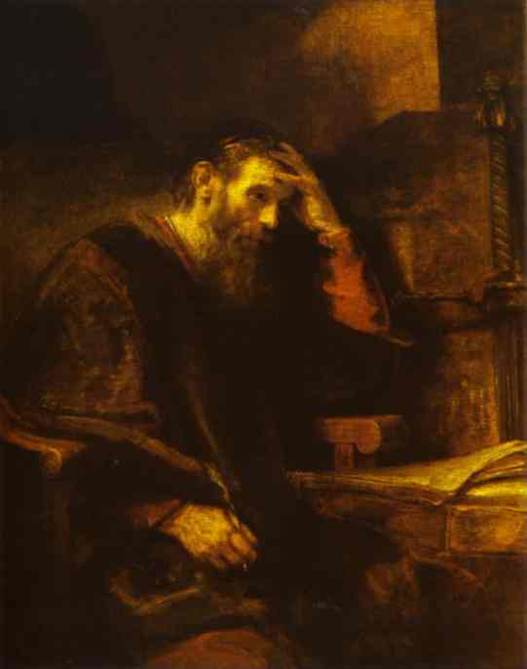
Vv. 13-14 Sovereignty Over Circumstance
Christian joy is best rooted in Romans 8:28.
Philippians 4:12.
There’s joy.
There’s pain.
Do not despise the thorns!
Ecclesiastes 7:14
In 2 Corinthians 12:7-10 Paul says, ⁷ “And lest I should be exalted above measure by the abundance of the revelations, a thorn in the flesh was given to me, a messenger of Satan to buffet me, lest I be exalted above measure. ⁸ Concerning this thing I pleaded with the Lord three times that it might depart from me. ⁹ And He said to me, “My grace is sufficient for you, for My strength is made perfect in weakness.” Therefore most gladly I will rather boast in my infirmities, that the power of Christ may rest upon me. ¹⁰ Therefore I take pleasure in infirmities, in reproaches, in needs, in persecutions, in distresses, for Christ’s sake. For when I am weak, then I am strong.”

Slide 35
Vs. 15 Sovereignty Over Suffering
Please don’t say that God has nothing to do with suffering or sickness in Scripture. The alternative is terrifying.
Note from Solomon 1 King 8:33, 35-36.
In Vv. 15 and 16 James links the forgiveness of sin with healing. Scripture often does this.
Luke 5:23: “Your sins are forgiven. Rise up and walk.”
John 5:14: “Afterward Jesus found him in the temple, and said to him, “See, you have been made well. Sin no more, lest a worse thing come upon you.”
Revelation 2:20-22: “I have a few things against you, because you allow that woman Jezebel, who calls herself a prophetess, to teach and seduce My servants to commit sexual immorality and eat things sacrificed to idols. ²¹ And I gave her time to repent of her sexual immorality, and she did not repent. ²² Indeed I will cast her into a sickbed, and those who commit adultery with her into great tribulation, unless they repent of their deeds.”

Slide 36
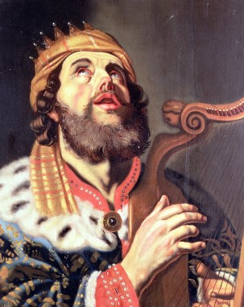
Sovereignty Over Prayer Vv. 16-18
The purpose of prayer.
The prayer “Of faith” (from Vs. 15) must mean something like: 1) as a Christian, and 2) according to God’s will.
James 4:3 – asking amiss.
1 John 5:14-15 – Asking accordingly.
“Father, if it is Your will, take this cup away from Me; nevertheless not My will, but Yours, be done.” Luke 22:42.
Sanctification is a community effort.
Level(s) of prayer power:
Private.
Family.
Corporate/church prayer.

Slide 37
A Sovereign Shepherd’s Sheep Vv. 19-20
This section is somewhat separate from the previous two as I’ve divided it.
James tells these readers to be vigilant over one another for each other’s safety, but he doesn’t say how – sometimes it’s tough love.
This is loving one another, isn’t it?
Jesus said, “Love one another as I have loved you.” He later says, “As many as I love, I rebuke and chasten.” Revelation 3:19a.
His chastening love is affirmed in Hebrews 12:6.

Slide 38
Sovereignty Over Us
So sing, pray, call for the leaders over you when you’re sick. Pray for healing and forgiveness. Remember Elijah and those who’ve gone before you. Share your faith. Watch for your brethren as they watch out for you.
Through it all, remember Romans 8:28’s categorical promise.
I close this magnificent book with you as James opens it: “My brethren, count it all joy when you fall into various trials, knowing that the testing of your faith produces patience. But let patience have its perfect work, that you may be perfect and complete, lacking nothing.” James 1:2-4.

Slide 39
God’s Sovereignty “What then shall we say to these things? If God is for us, who can be against us?” Romans 8:31

Slide 40
WORSHIP SONG –
CLOSING SONG –
I’ll See You

Slide 41
As I walk through this land of milk and honey
all I see are people working for money.
No love or care for their fellow man,
no rhyme or reason for their dreams or their plans.
Everyone’s turned from the ways of The Maker,
a mind’s eye blind no givers only takers.
Its all gonna end,
One way or another my Friend.

Slide 42
I’ll see You when we get there,
when we all get there, if we all get there.
I’ll see you when we get there,
when we all get there,
through our songs and prayers.

Slide 43
He’s gonna come on the wind and a cloud,
Tearin’ down the walls that were built by the proud.
Pestilence and hunger will devour the land,
once fertile fields will be turned to sand.
Thousands will be missing and the people will shout,
“What’s going on, what’s this all about?”
They’ll still be waiting and looking for a sign,
this trains a leaving don’t get left behind.

Slide 44
I’ll see You when we get there,
when we all get there, if we all get there.
I’ll see you when we all get there,
when we all get there,
through our songs and prayers.

Slide 45
As for me..I’m not really worried,
I can see clear, though my future’s kinds blurry.
The road may be tough and my cup maybe empty,
when the good Lord is for me who can be against me?
And I’ll stand in the gap for you my friend
and even if I fail, He’ll be there ‘til the end.
Commanding the heavens
from his great and golden chair,

Slide 46
I’ll see you my brothers, when we get there.
I’ll see You when we get there,
when we all get there, if we all get there.
I’ll see you when we all get there,
when we all get there,
through our songs and prayers.

Slide 47
BENEDICTION –
CH JOHNSON

